Slide 1
Data visualization
A whirlwind tour. Lakshman Balaji Biostatistician, Center for Resuscitation Science BIDMC lbalaji@bidmc.harvard.edu

Slide 2
Plan
Importance of data visualization
Interesting visual processing/perception phenomena
General principles of figure design
What type of chart/figure should you use?
Commonly used chart types
Tools to create figures
References

Slide 3
Why is data visualization important?
Let’s look at an illustrative example.

Slide 4
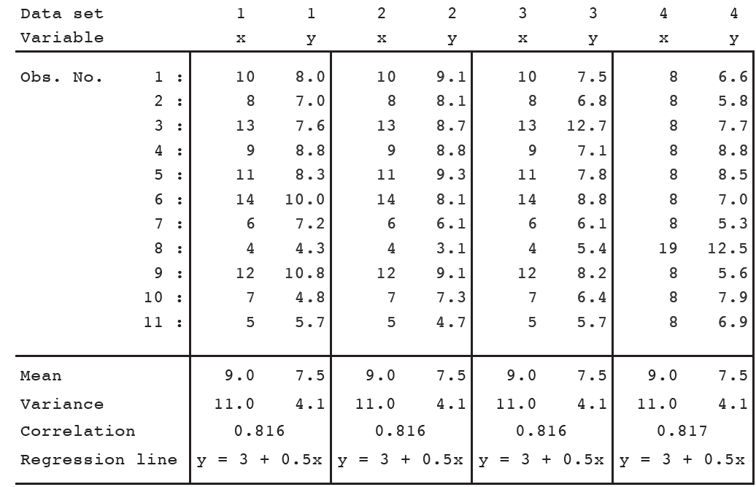
Anscombe’s Quartet
What are the things that you notice in this data?
Notes:
Published by Francis Anscombe in 1973

Slide 5
Anscombe’s Quartet
What are the things that you notice in this data?
Notes:
Published by Francis Anscombe in 1973

Slide 6
Anscombe’s Quartet
What are the things that you notice in this data?
Notes:
Published by Francis Anscombe in 1973

Slide 7
Anscombe’s Quartet
What are the things that you notice in this data?
Notes:
Published by Francis Anscombe in 1973

Slide 8
Anscombe’s Quartet
What are the things that you notice in this data?
Notes:
Published by Francis Anscombe in 1973

Slide 9
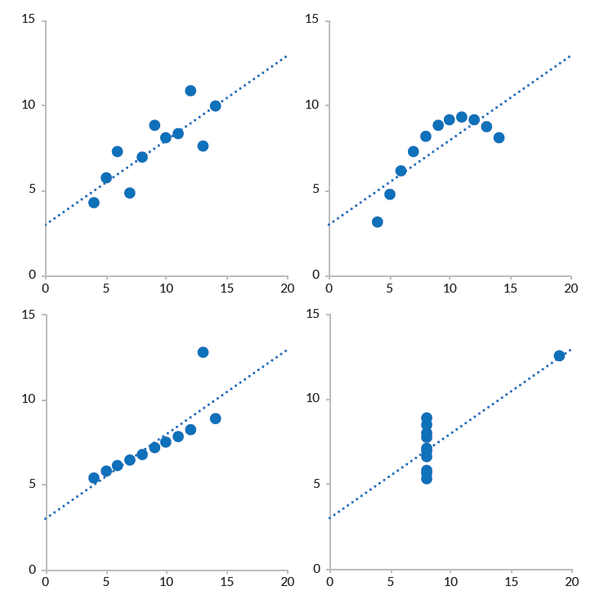
What did we miss?
1
The positive correlation between x and y in the first three figures
2
The curvature in the top-right figure
3
(Possibly) the outliers in the bottom two figures
Data visualization is great for exploring relationships, presenting complex data in an intuitive way, and highlighting aspects of the data that you feel are important.

Slide 10
Visual processing/perception
Being aware of these visual phenomena can help greatly with creating data visualizations.
Notes:
You may already be using some of these principles, but nice to see them enumerated.

Slide 11
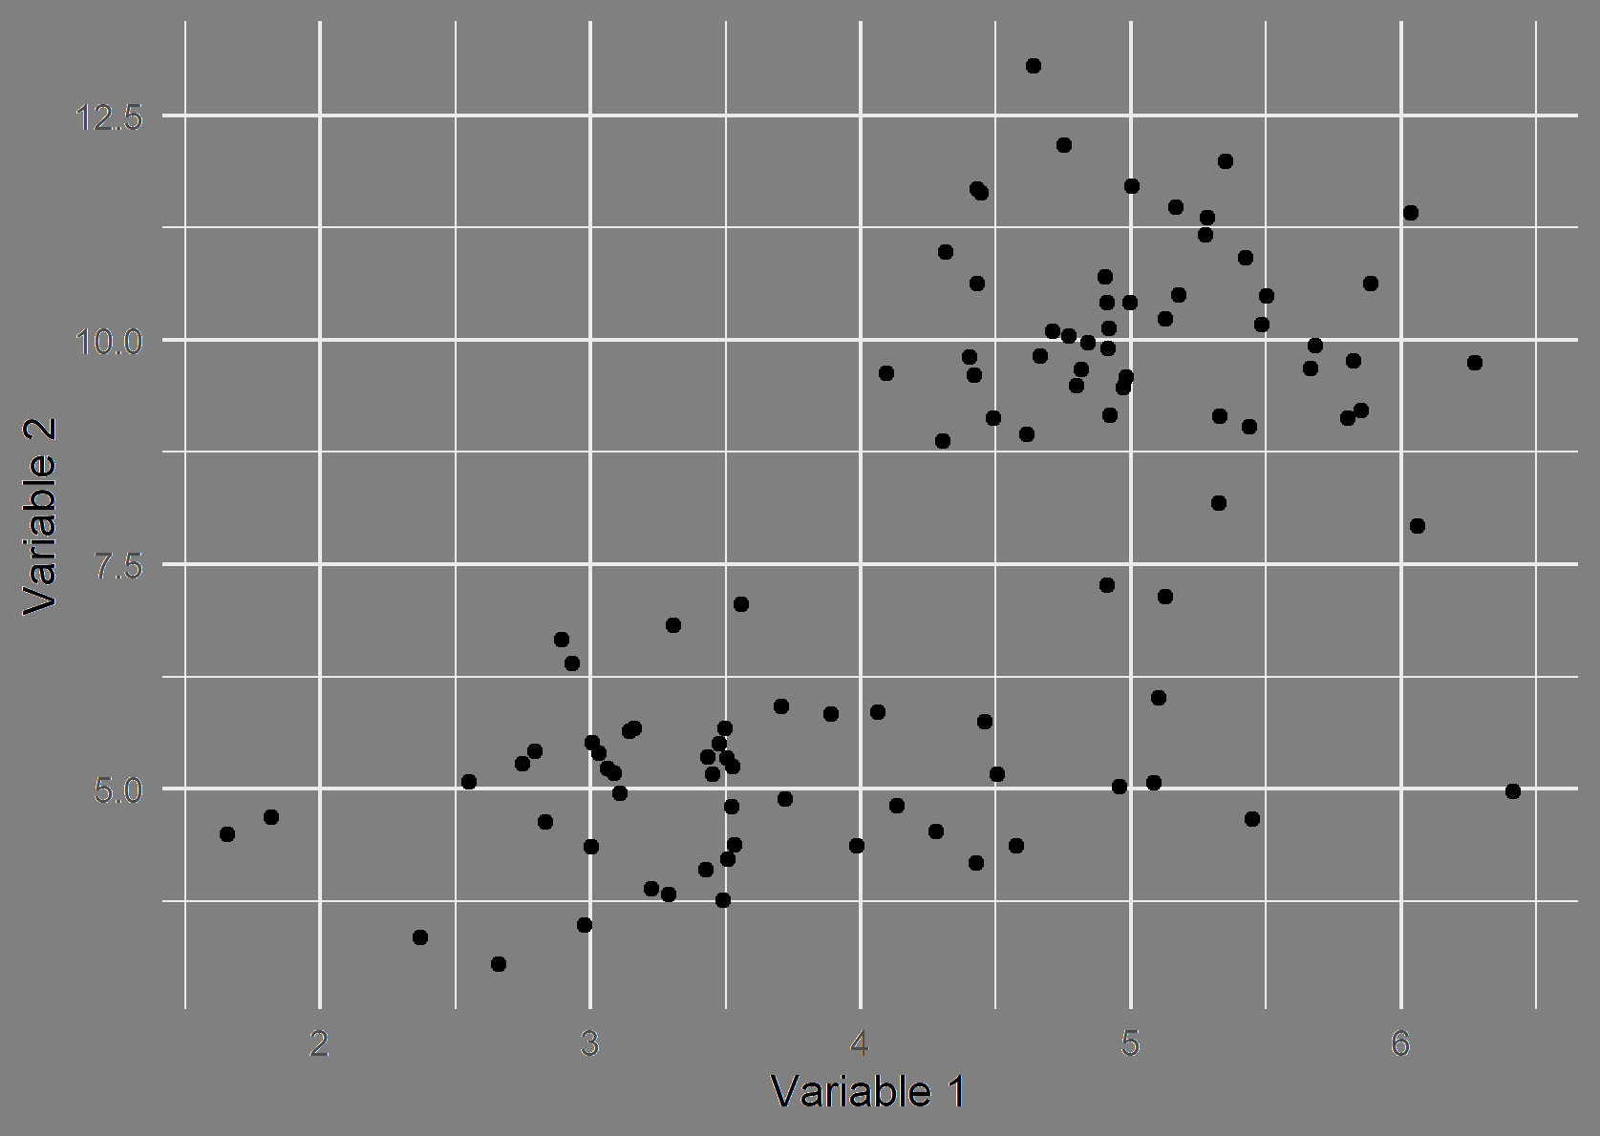
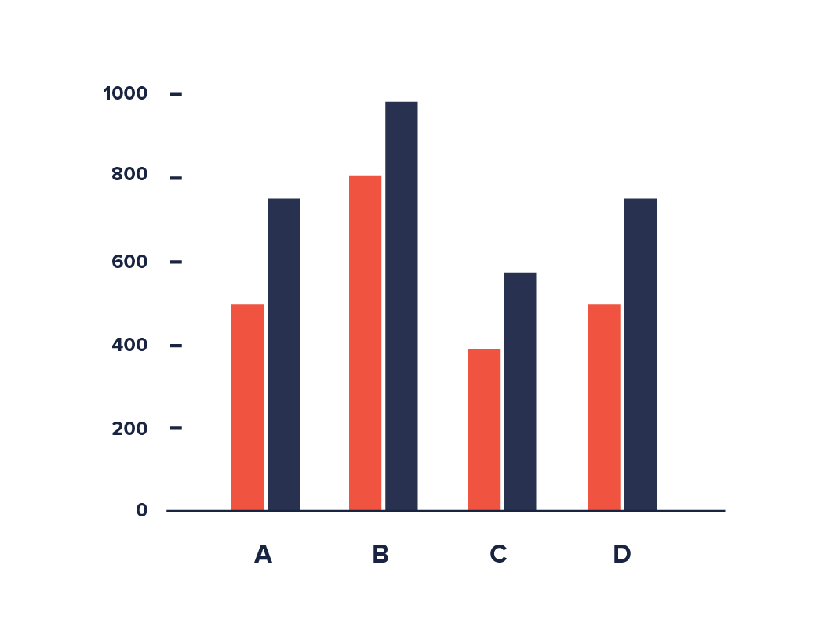
Proximity
Objects which are closer to one another are perceived as belonging to the same group.
For example, in this image, you may see two different groups, one cluster at the top right and the other at the bottom left.
Notes:
If you have ever made a grouped barchart, you have made use of this principle.

Slide 12
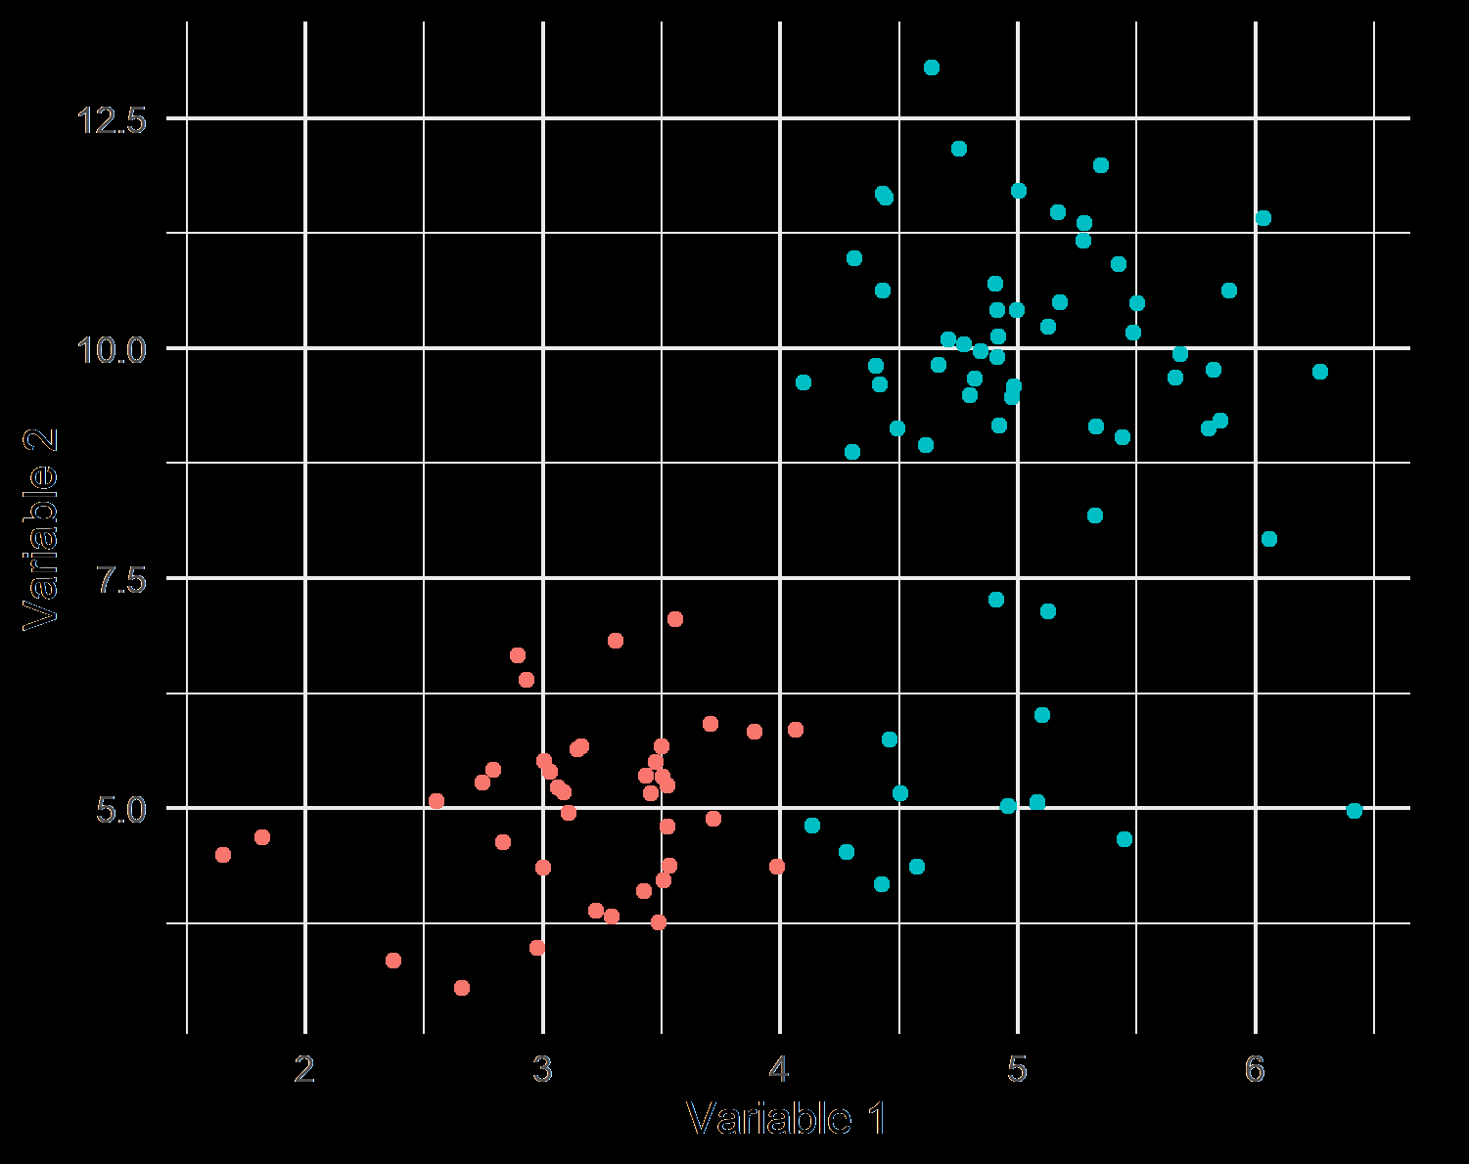
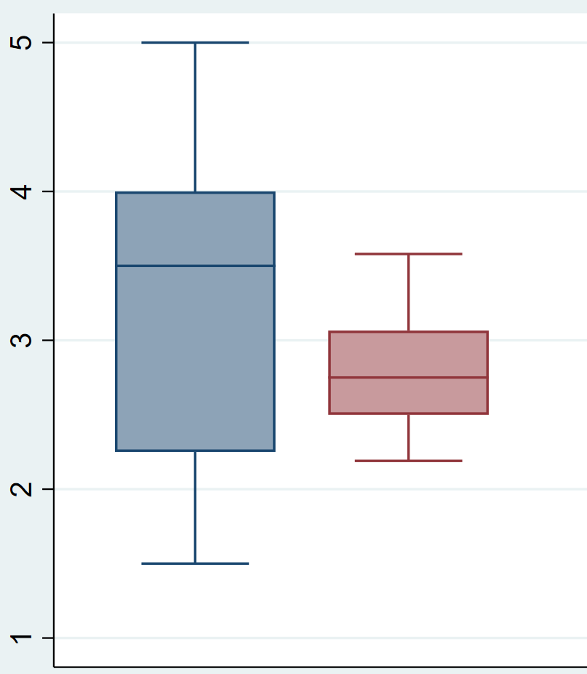
Color
Objects of the same color are considered to belong to the same group.
For example, in the same image as before, if I change the colors a bit, your perceptions of the groups also changes.
Notes:
Here, notice the upper group ends with y = 7.5. But after I change the colors, you see the upper group extending further down. You make use of this principle every time you pick colors for your charts. For example, in this boxplot.

Slide 13
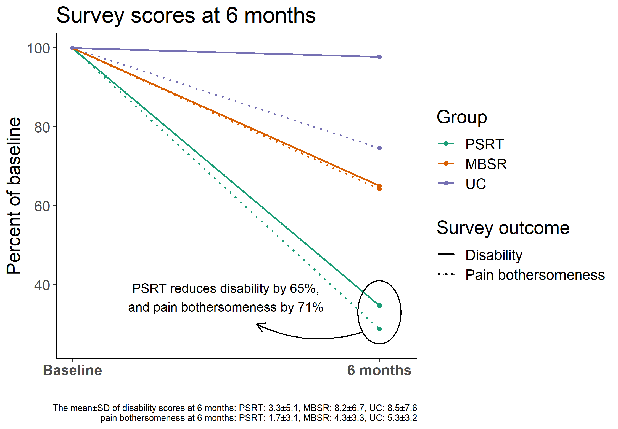
Enclosure
Enclosed objects are seen are constituting a group.
For example, if you wish to draw attention to a certain cluster, just draw a circle around it. Great for pointing out special areas.
Notes:
Great for annotations. We used this in a grant submission to draw attention to the fact that our study group reduced the outcome variable the most!

Slide 14
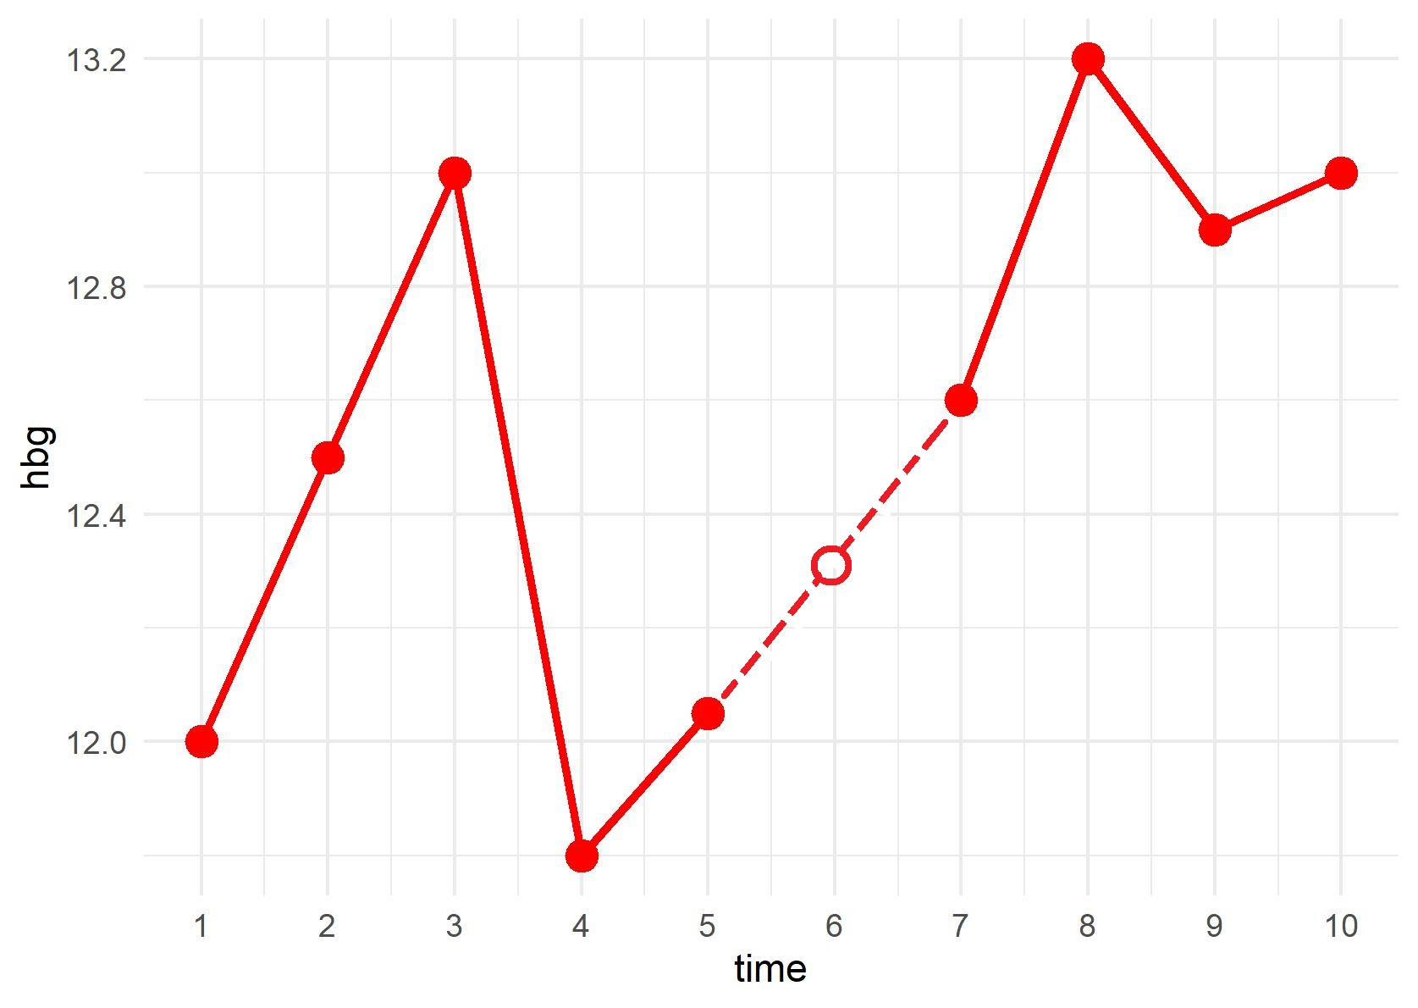
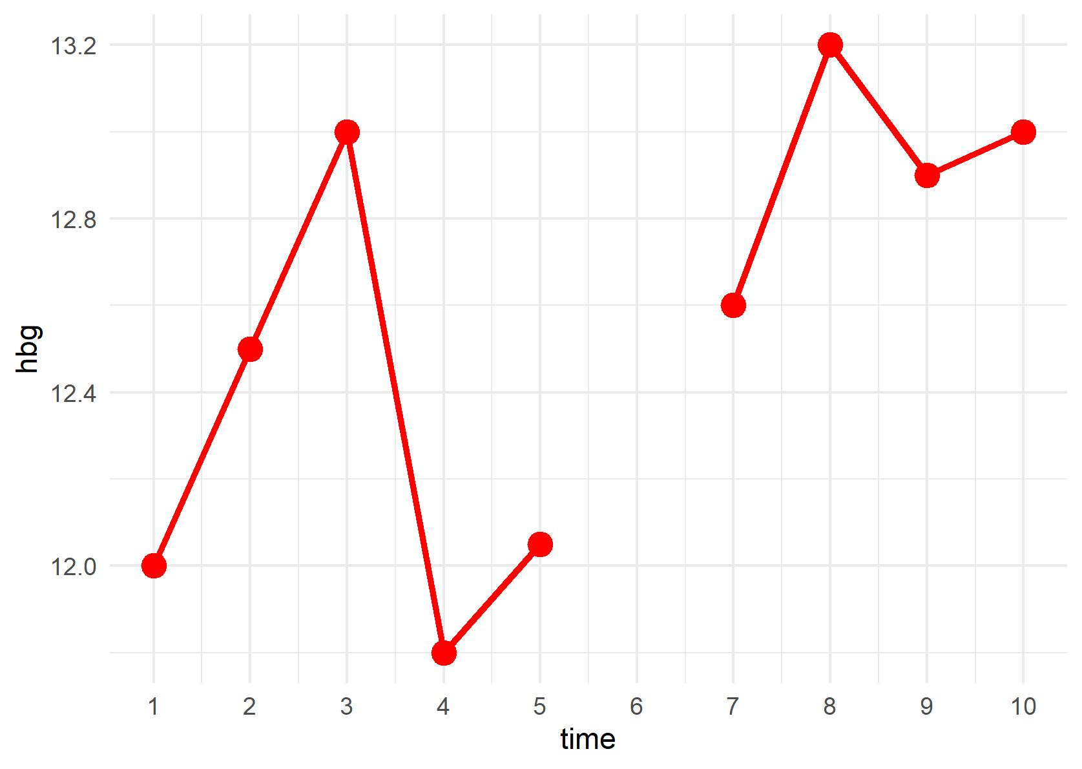
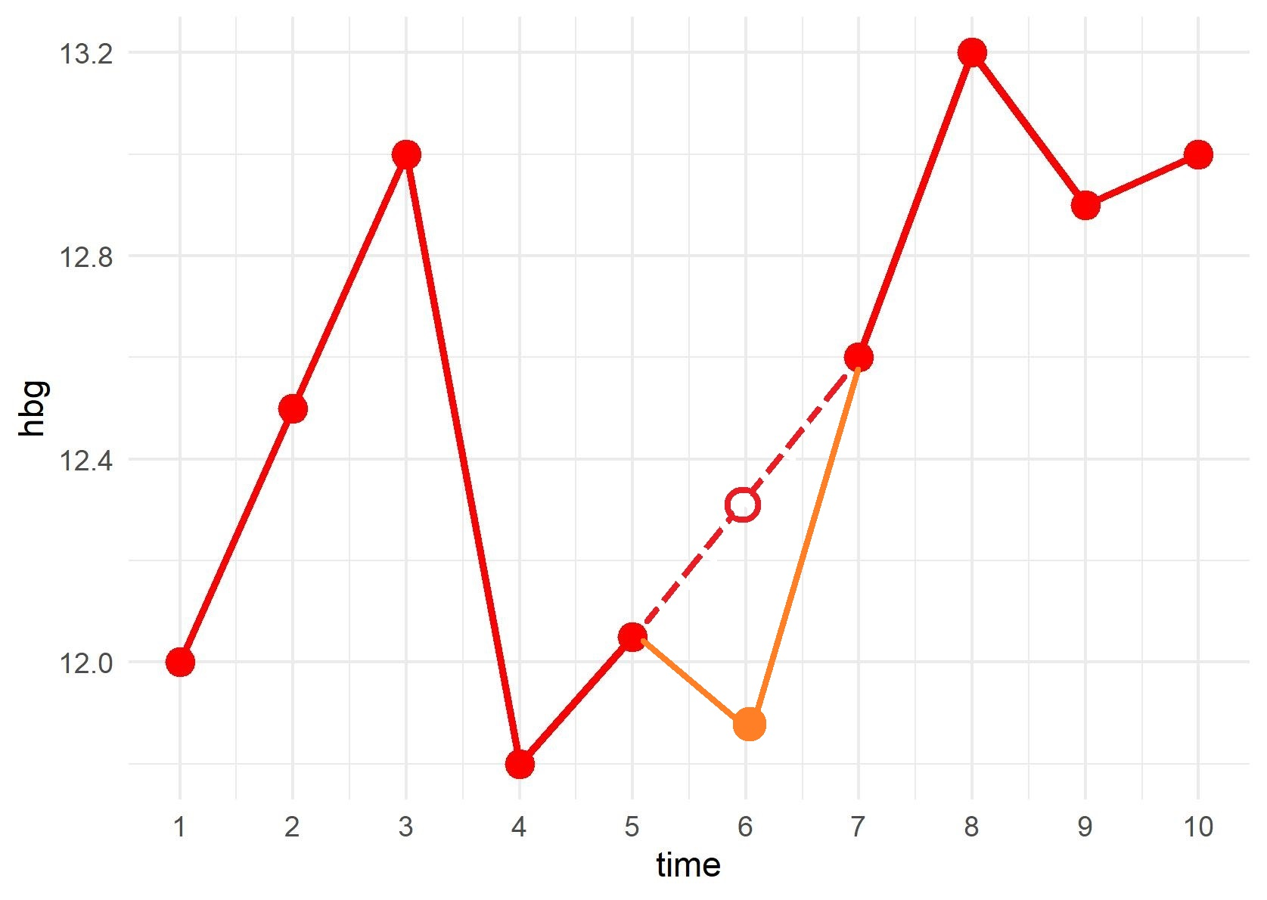
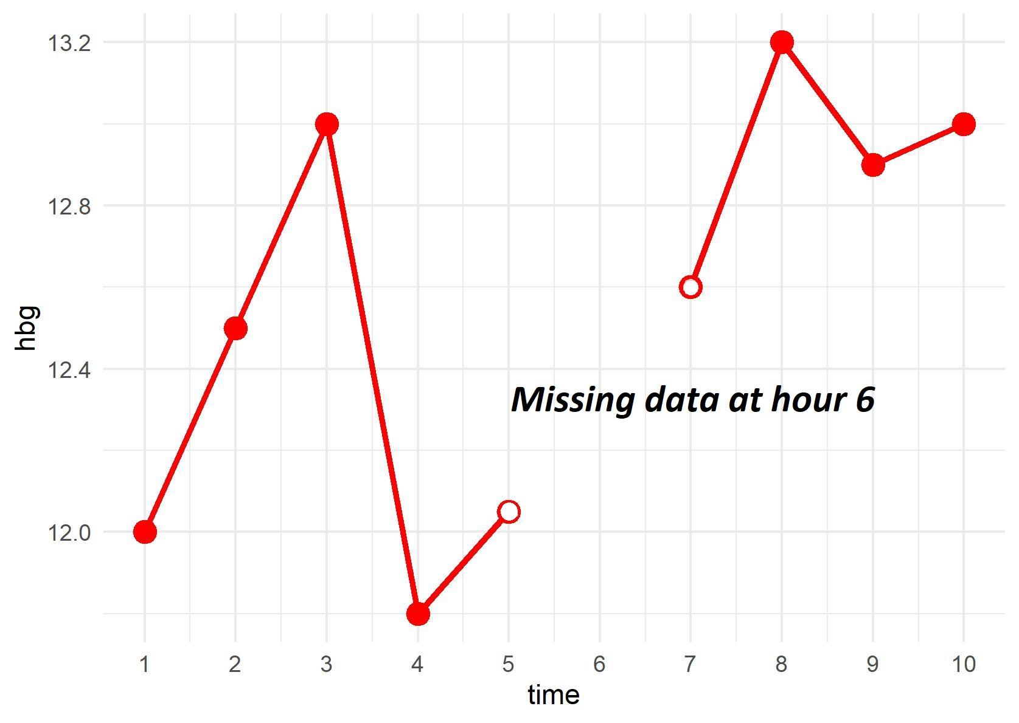
Closure
Our brains don’t like incompleteness, they try to close areas that are left open.
To avoid this problem, clearly specify when data is missing
Notes:
This is troublesome if the effect of, say, a drug is being estimated: you don’t want folks interpolating or filling in the missing values themselves.

Slide 15
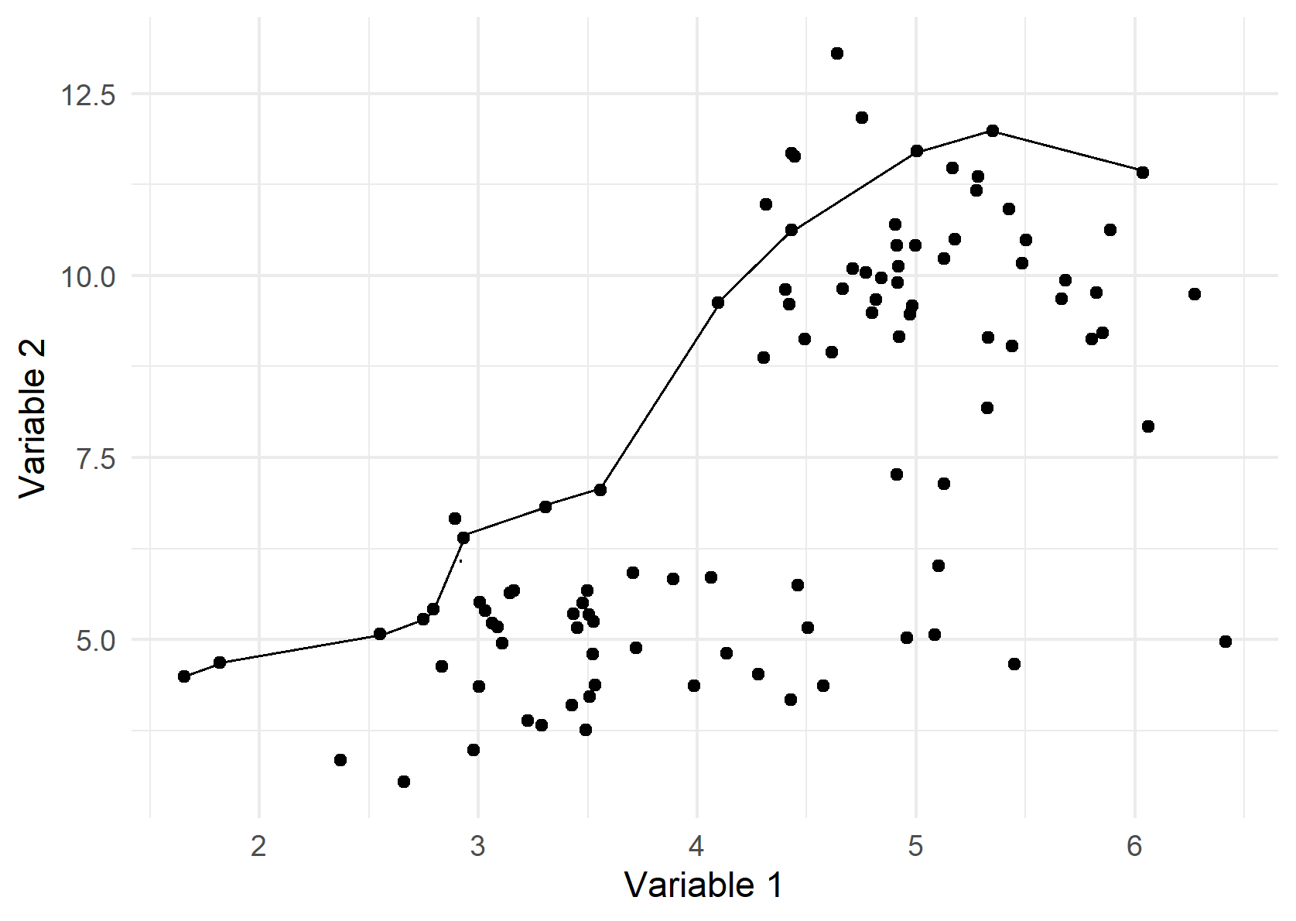
Connection
Elements that are connected are perceived as members of the same group.
Notes:
Changes the meaning of this figure entirely. Now, the connected set of dots could be repeating observations for the same person.

Slide 16
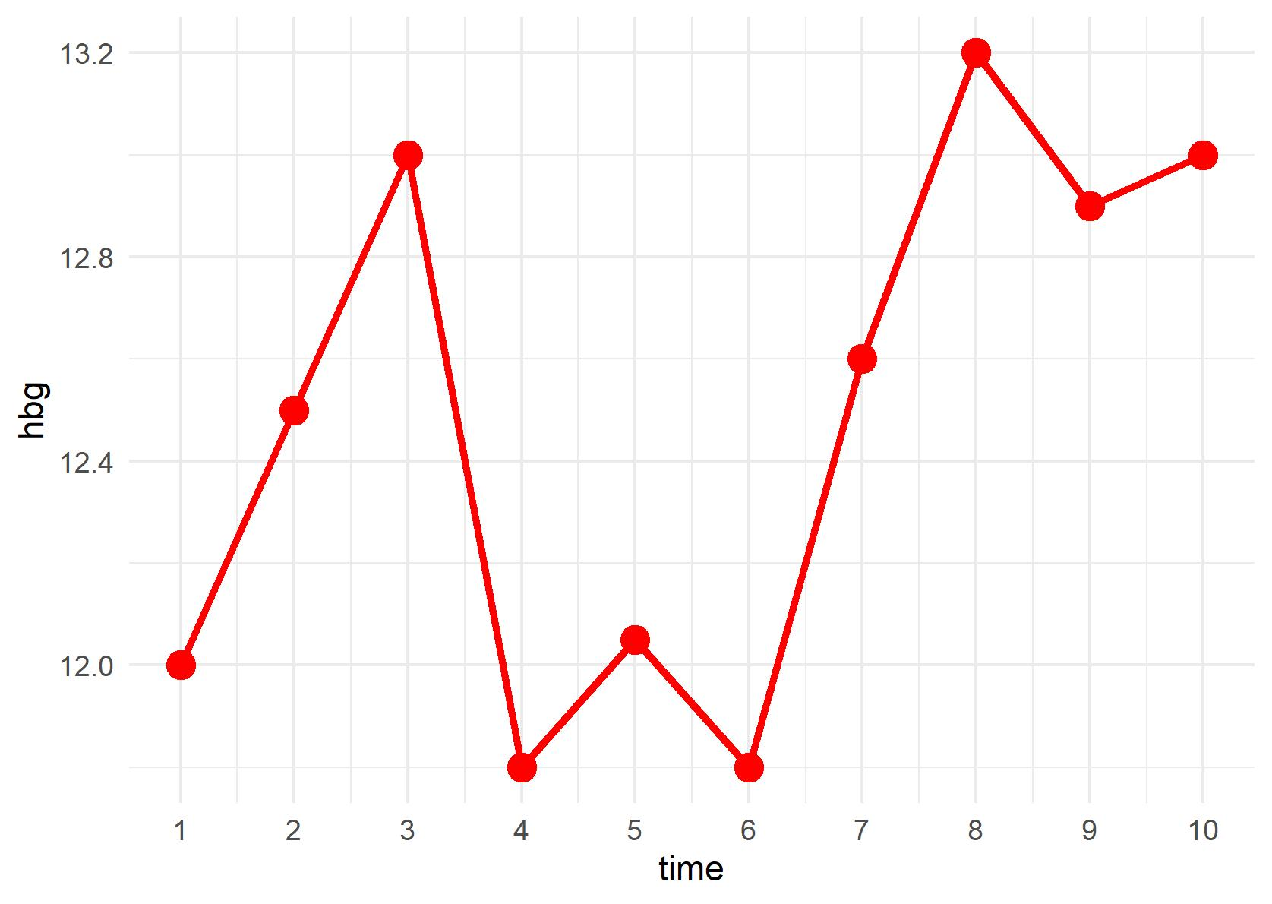
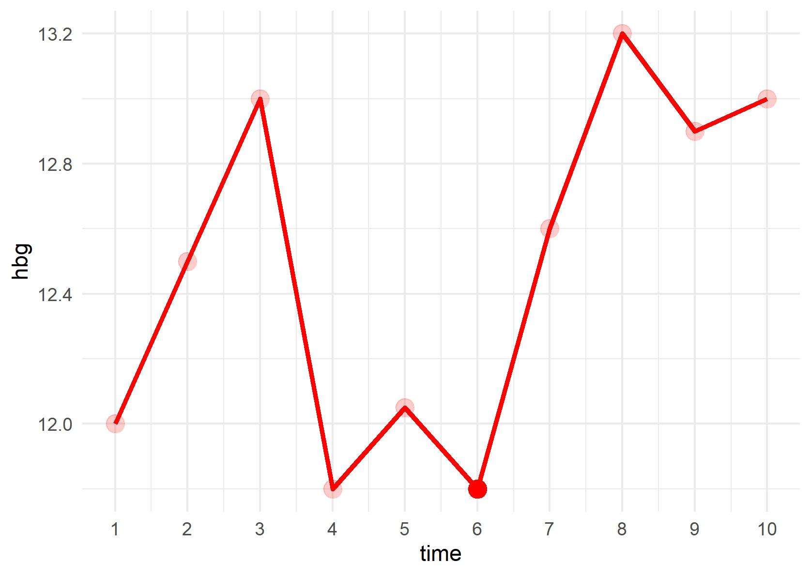
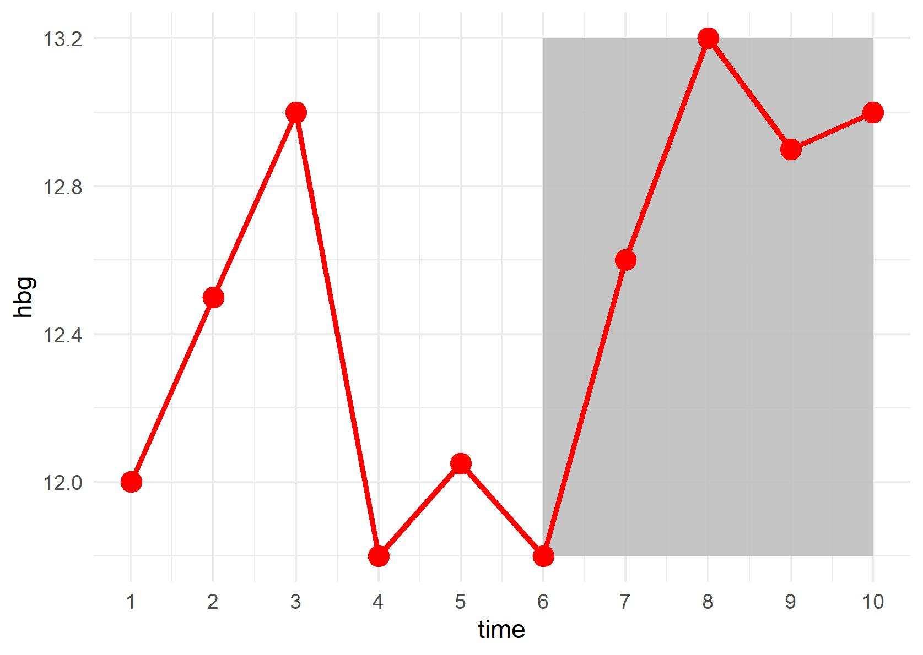
Preattentive processing
A technique by which you use visual principles to direct attention to certain portions of your figure.
Notes:
For example, here, we use transparency to make all the actual data-points dull, and keep the point at time = 6 opaque, if we wanted to talk specifically about this point. Could use shading to highlight points after time 6. Could use sharpness of points versus blurriness.

Slide 17
General principles for figure design
These serve as rules that can guide the creation of any chart.
Notes:
You may already be using some of these principles, but nice to see them enumerated.

Slide 18
General principles for figure design
Keep these in mind for all figures:
1
Make sure you’re showing the data that is important.
2
Remove clutter.
3
Integrate text and figure. Make sure figure is completely self-explanatory.
4
Don’t be afraid to split data.
5
Use greys.

Slide 19
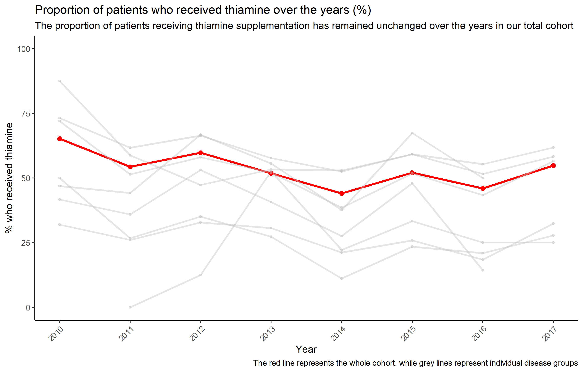
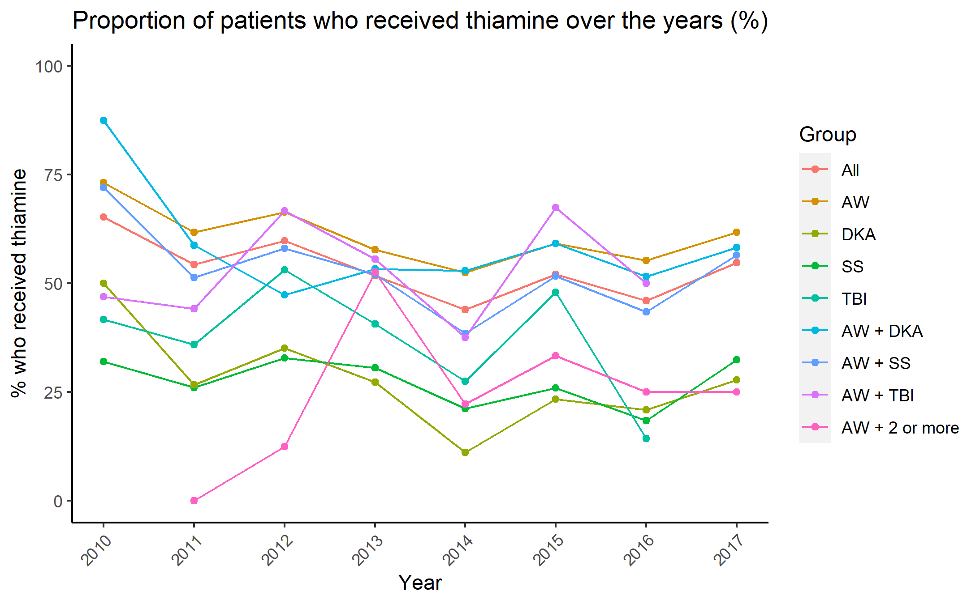
1. Make sure you’re showing the data that is important
Notes:
Consider chopping data to show only what is important. If all data must be shown, use preattentive processing tips to direct attention of the reader to where you want.

Slide 20
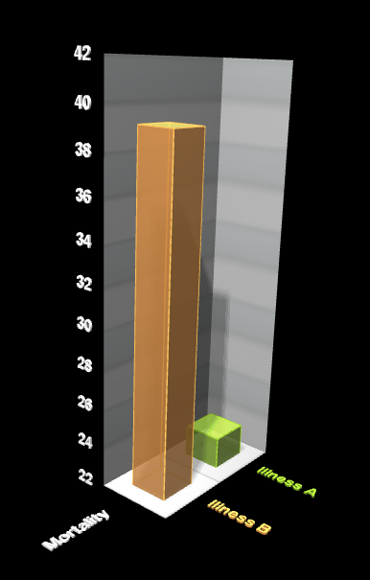
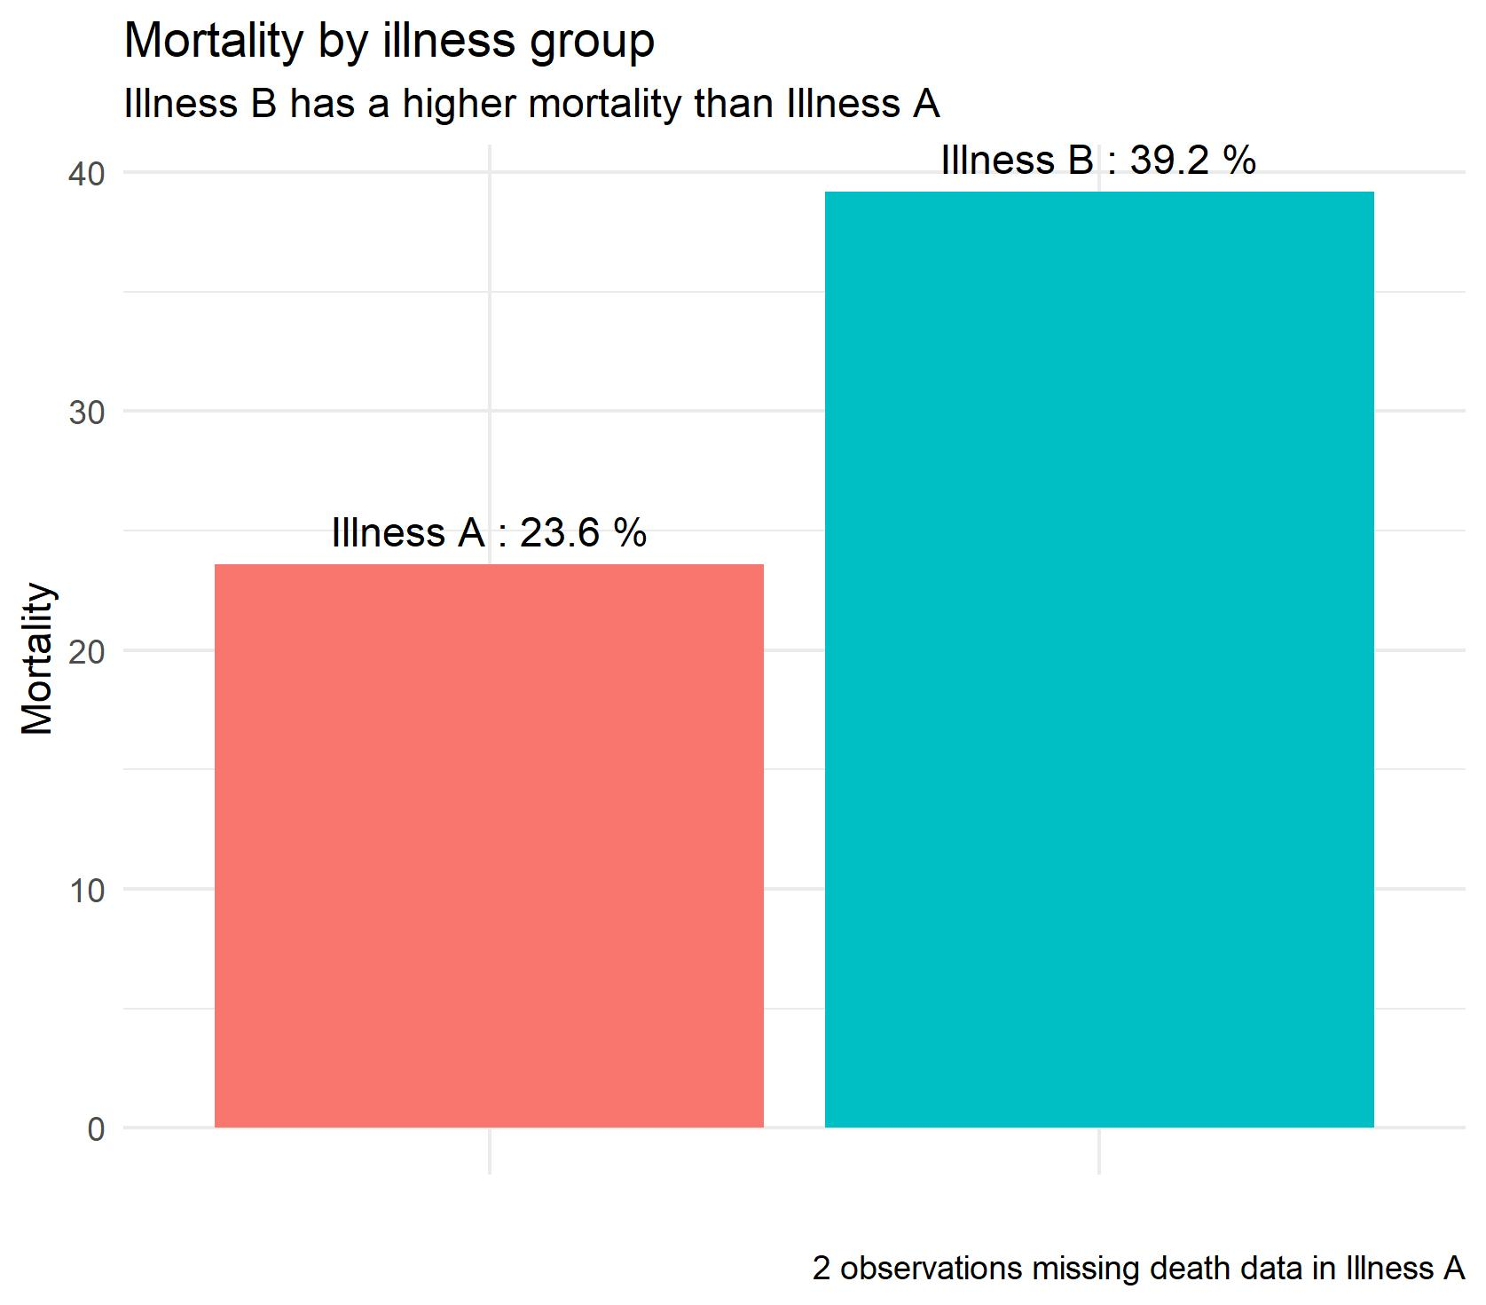
2. Remove clutter
Notes:
Perspective is unnecessary. The axes don’t need to be labelled at every 2 units (also note that the axis start at 22, which is not a good idea for a bar chart). In the barchart, we get rid of X axis labels, and change scale of y axis, and use annotations to specify the levels in illness A and B. We could even get rid of the y axis scale from a a pure data viz perspective but journals would probably want it. Data:ink ratio. Try to keep it lean and mean.

Slide 21
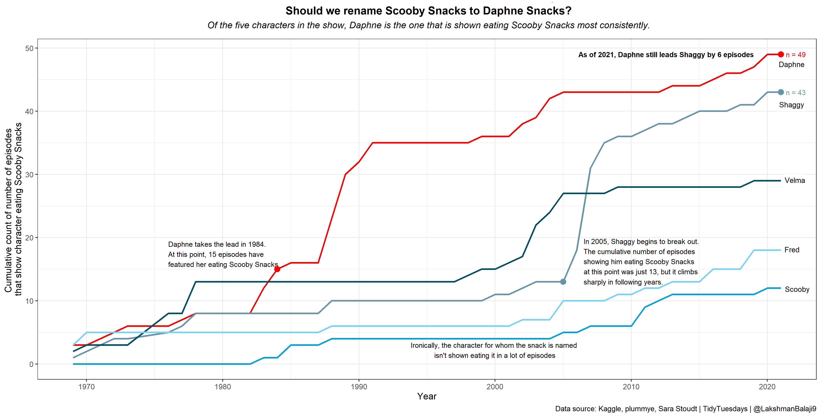
3. Integrate text and figure. Make figure self-explanatory.
Notes:
This is a light-hearted example (Scooby Doo). You may not be able to use so many annotations in a scientific paper. Instead, you could use it in a limited fashion as shown in this second image (survey scores at 6 months). Make sure essential components such as title, axes titles, legends, scales and explanatory annotations/captions are present.

Slide 22
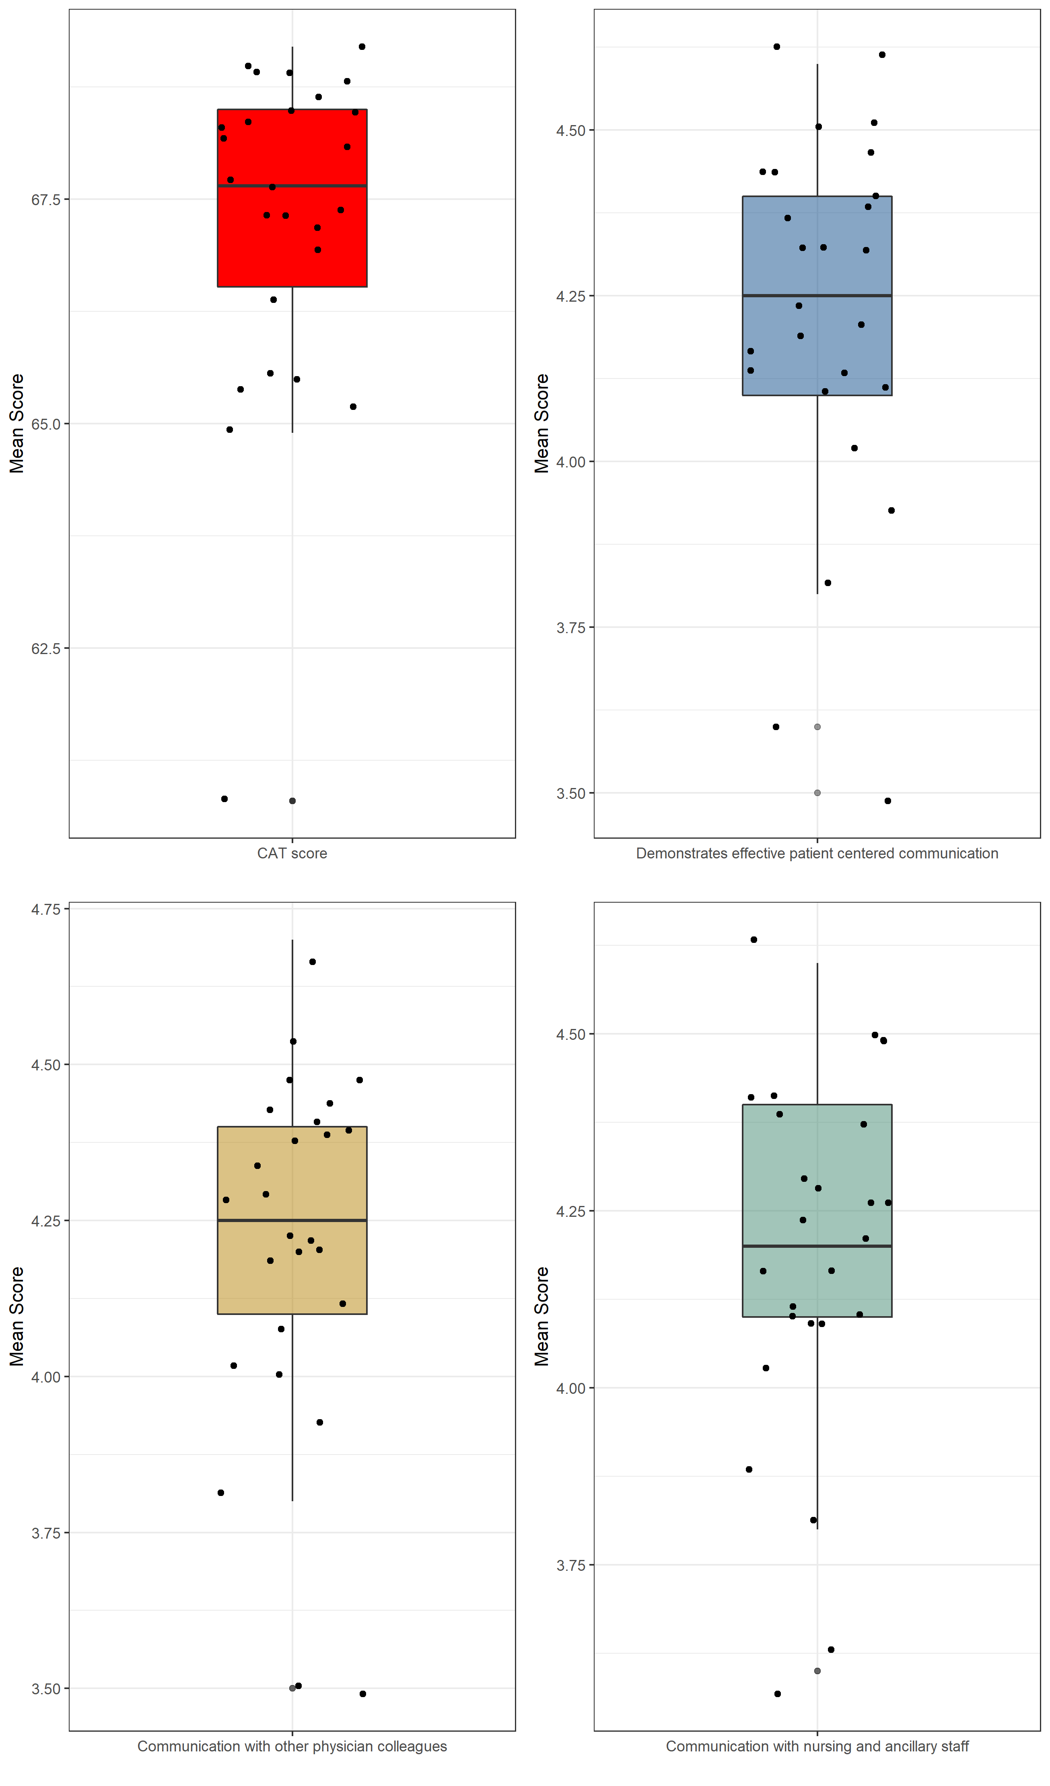
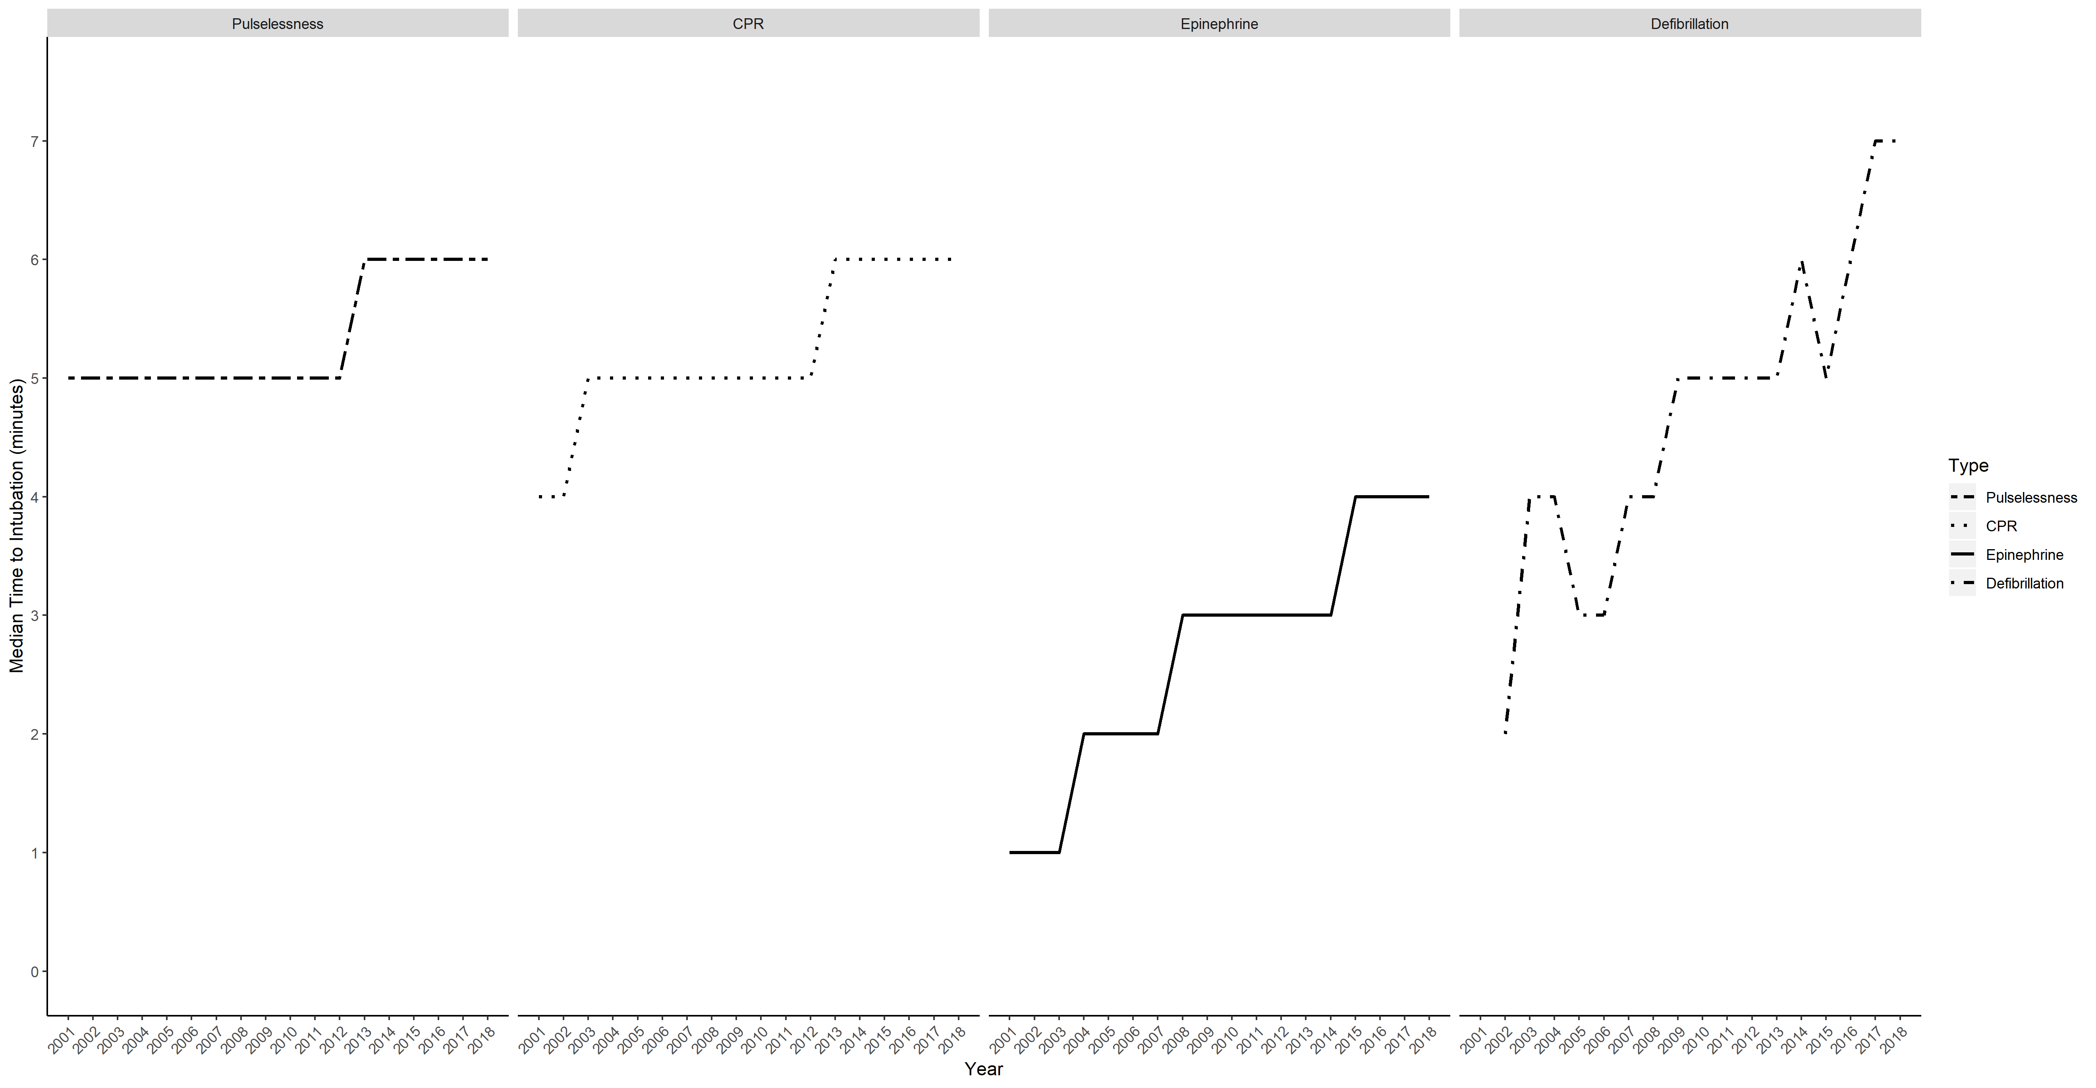
4. Don’t be afraid to split data up
Notes:
This is called faceting or arranging in a grid. Saves space, makes compact, and you can manage to submit 1 image instead of 4. Equivalent of having your cake and eating it too. Avoid the spaghetti chart.

Slide 23
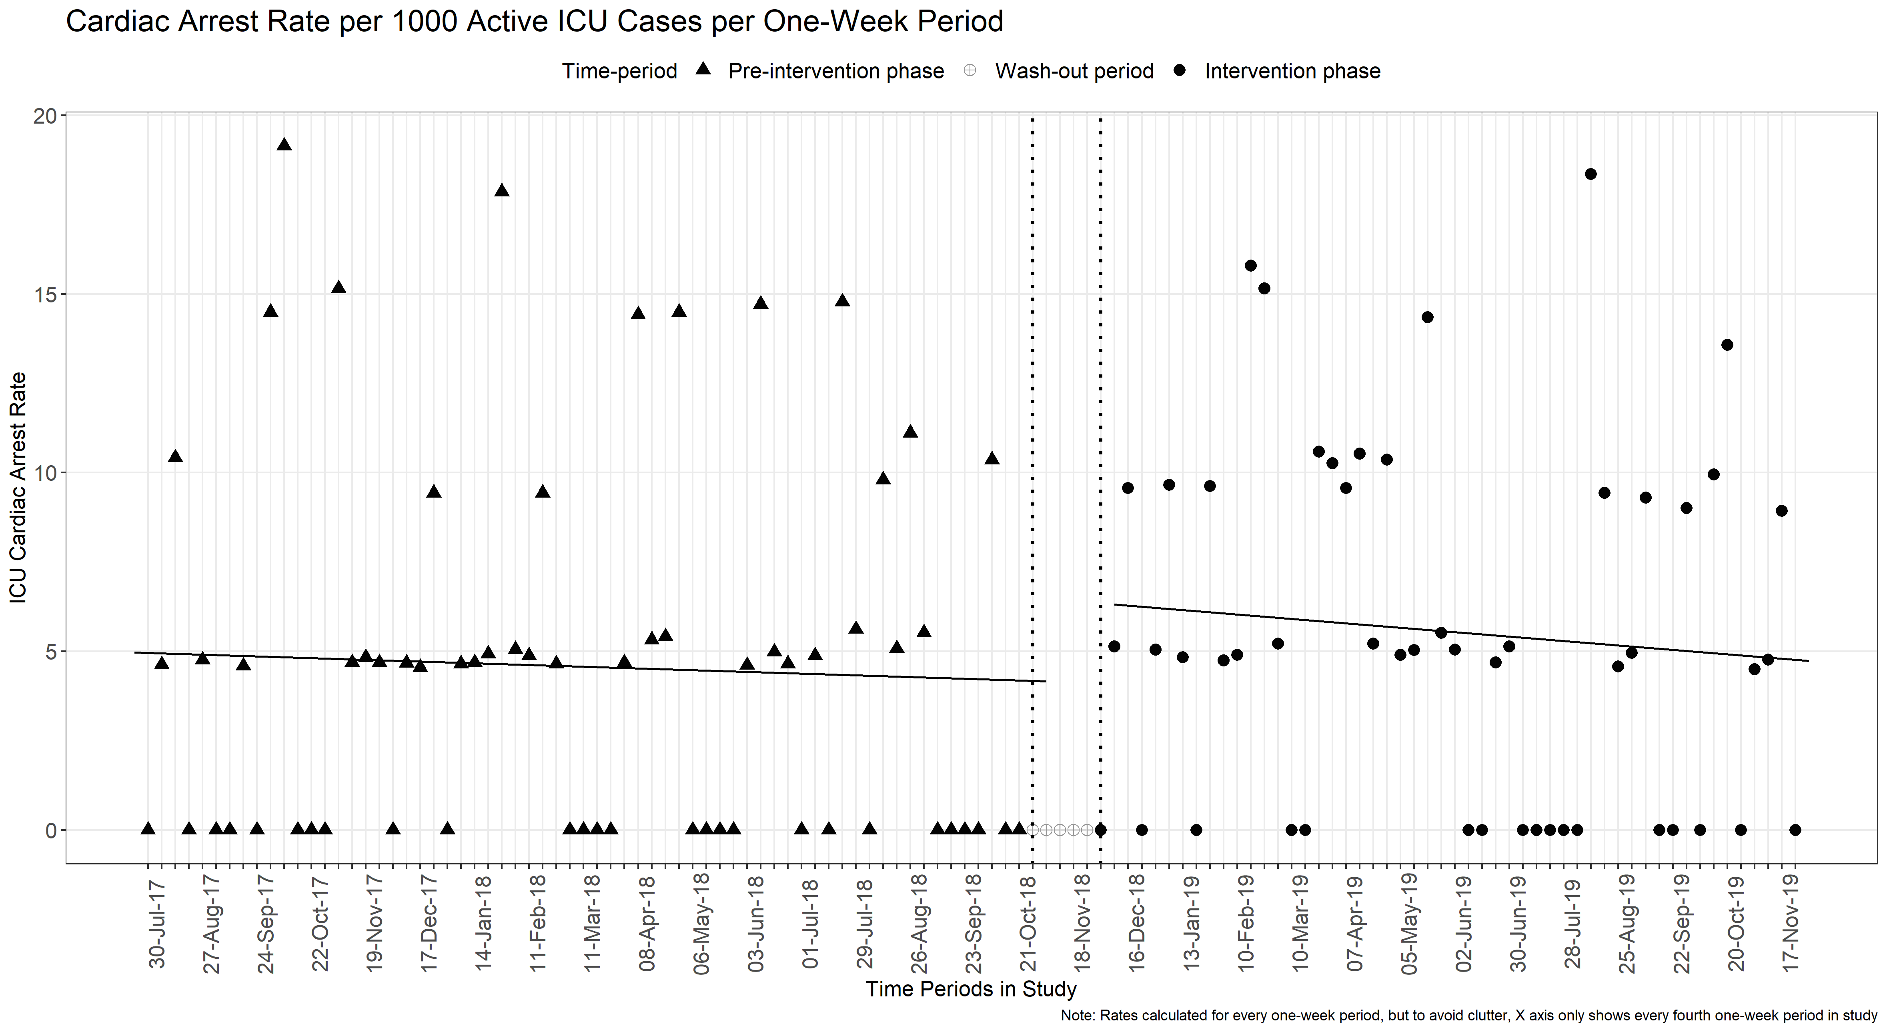
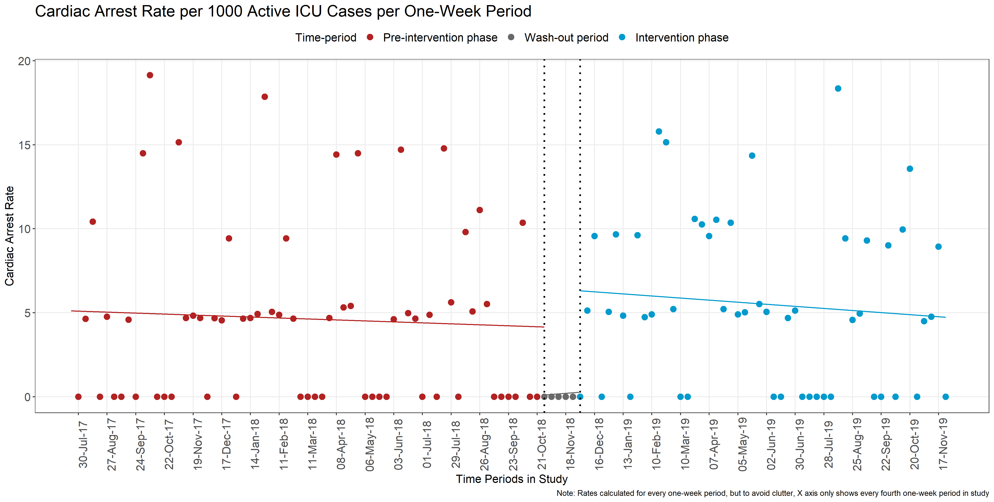
5. Create an image without colors at first
Notes:
Avoid colors at first because it lulls you into thinking the figure is finished. Create in greys so that you are forced to think about which aspects to highlight and which ones to not highlight. Also, could save you money if you decide to not publish in color. Also, keep in mind color-blind folks.

Slide 24
What type of chart/figure should you use?
Notes:
You may already be using some of these principles, but nice to see them enumerated.

Slide 25
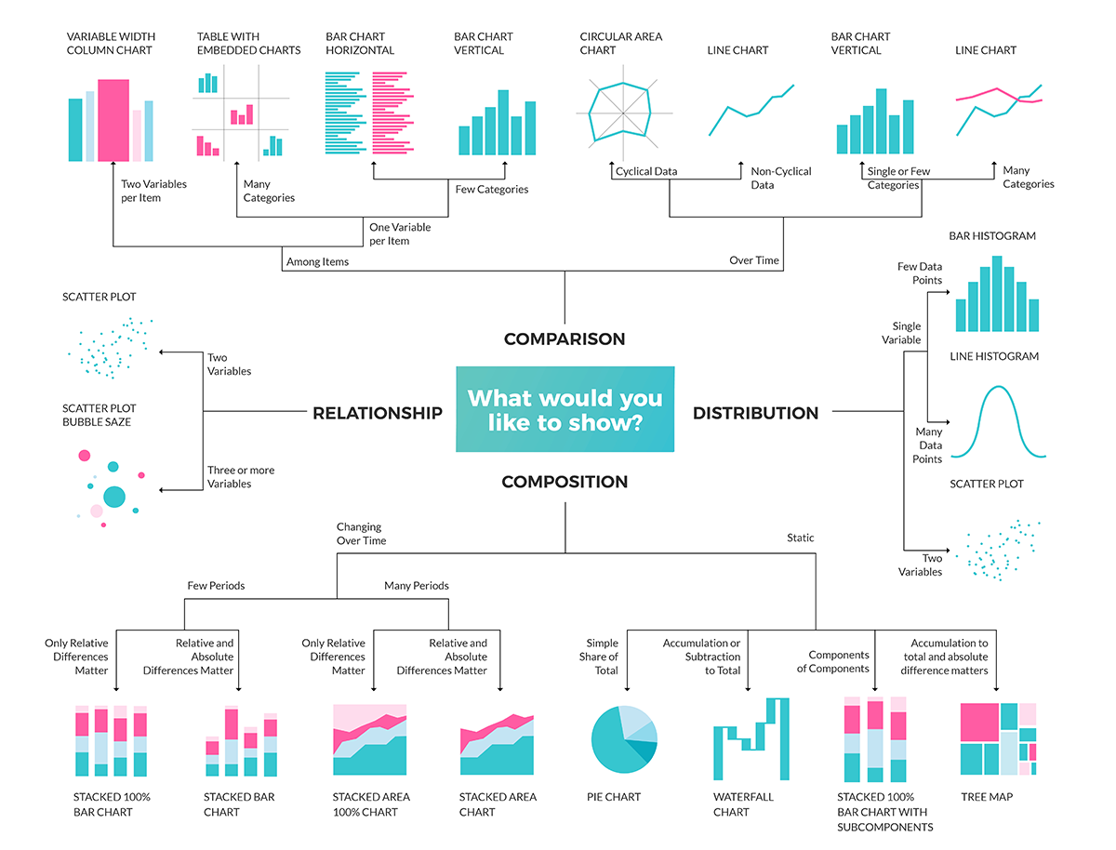
There are many, many figure types to choose from.
Image from https://education.microsoft.com
Notes:
But in the end, the figure that you go with depends on two things: 1. the data that you have and 2. the message that you want to convey.

Slide 26
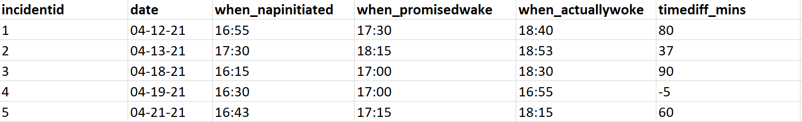
The “Broken_Promises” Dataset.
A dataset of naps that my girlfriend took.
Sample of 5 rows and all variables from the dataset.
Notes:
But in the end, the figure that you go with depends on two things: 1. the data that you have and 2. the message that you want to convey.

Slide 27
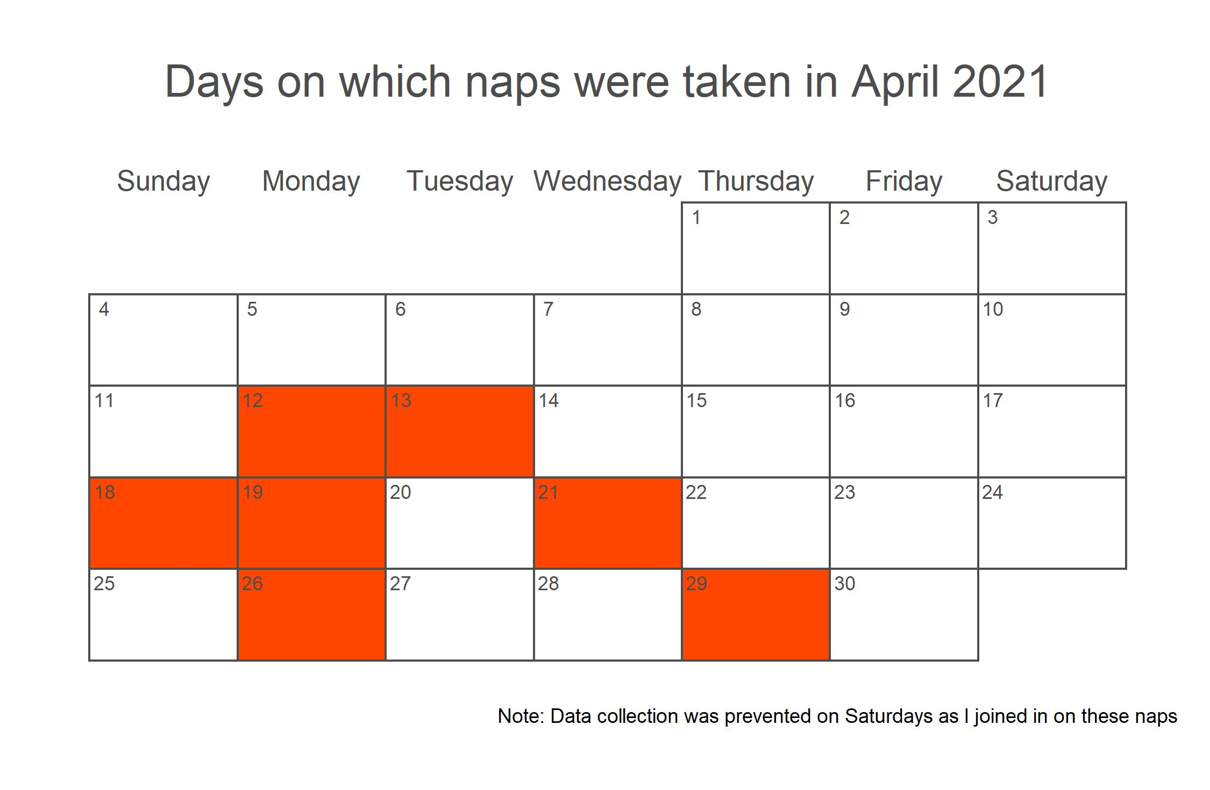
If I wanted to show the distribution of naps…
Sample of 5 rows and all variables from the dataset.
Notes:
But in the end, the figure that you go with depends on two things: 1. the data that you have and 2. the message that you want to convey.

Slide 28
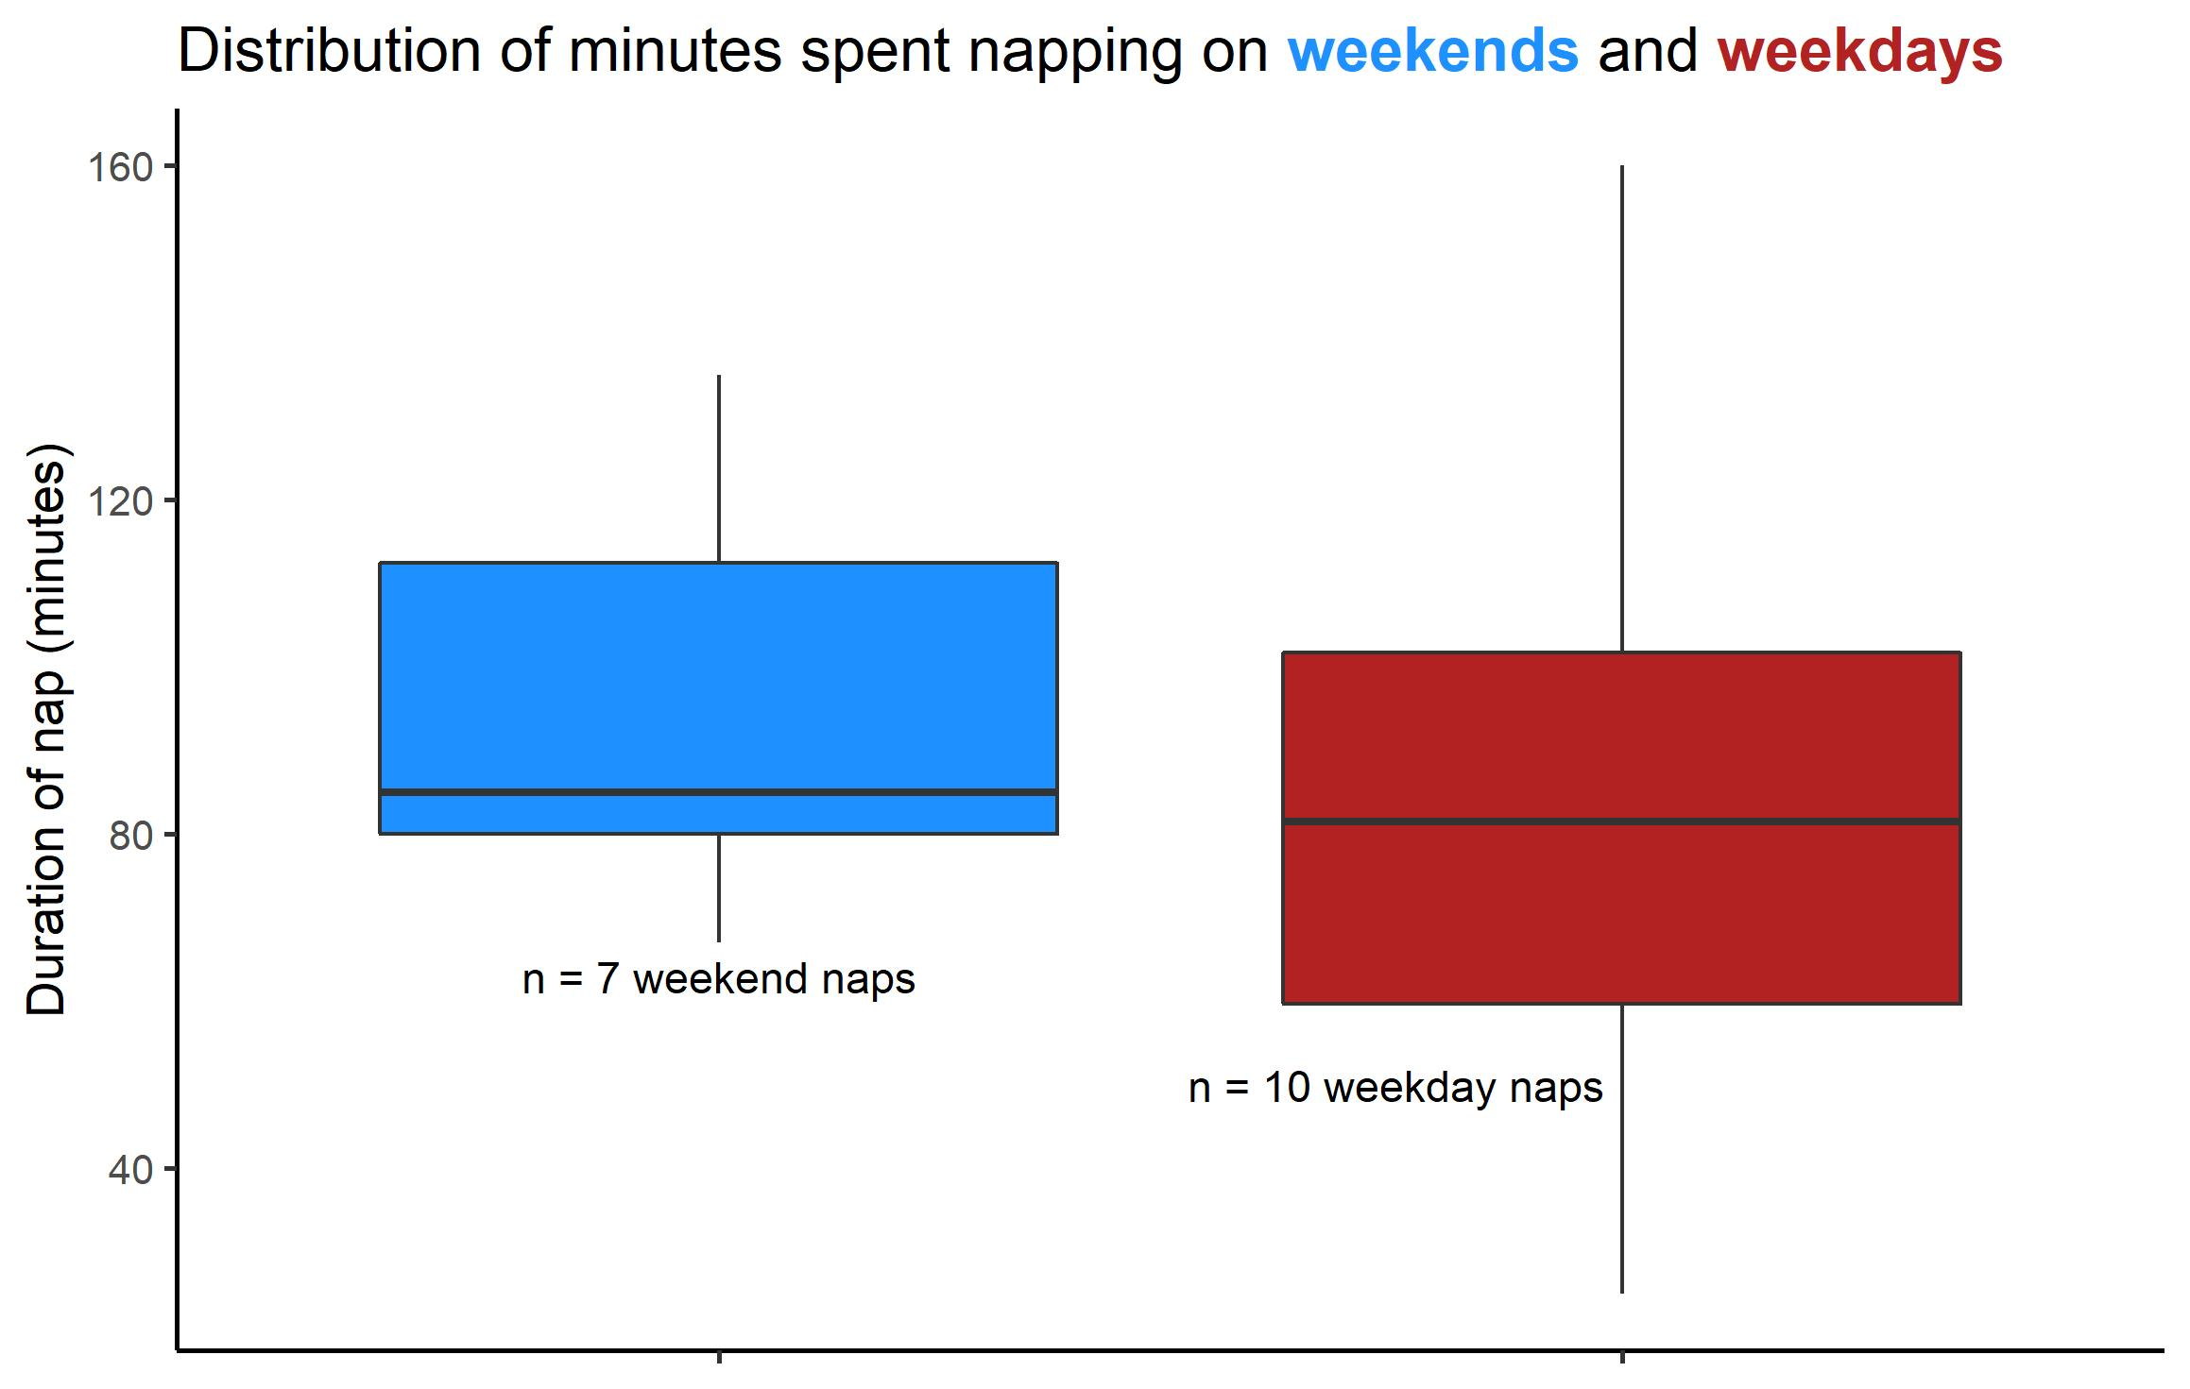
If I wanted to find out if she sleeps longer on weekends…
Sample of 5 rows and all variables from the dataset.
Notes:
But in the end, the figure that you go with depends on two things: 1. the data that you have and 2. the message that you want to convey.

Slide 29
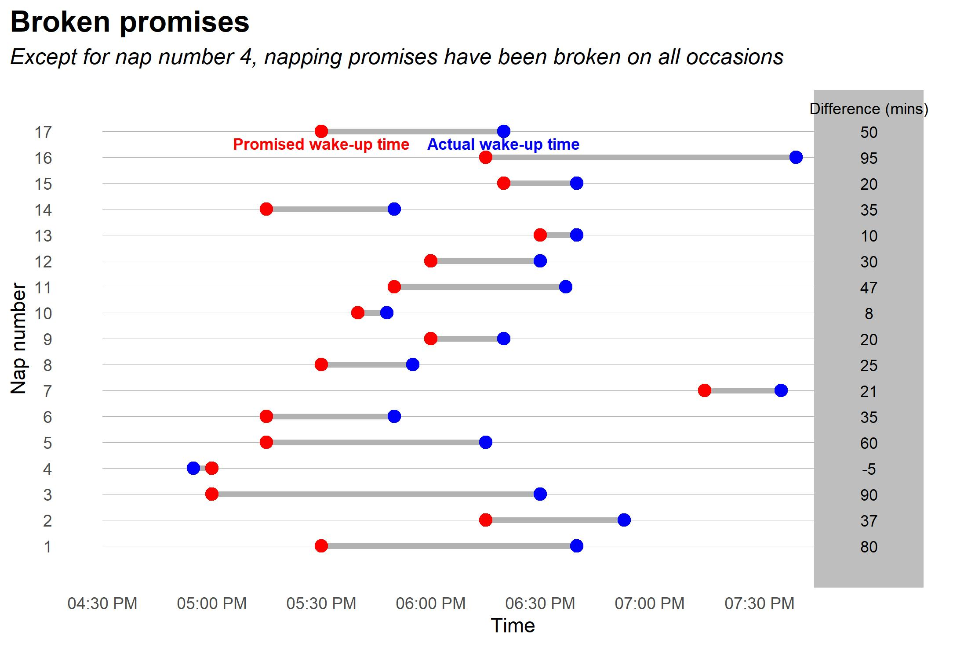
If I wanted to point out how much she falls short of her own targets…
Notes:
Dumbbell plot

Slide 30
What chart should you use?
The only person that can decide this is you. You need to look at your data and figure out what needs to be communicated to the reader. Based on that decision, you pick a chart.

Slide 31
Commonly used chart types
Notes:
You may already be using some of these principles, but nice to see them enumerated.

Slide 32
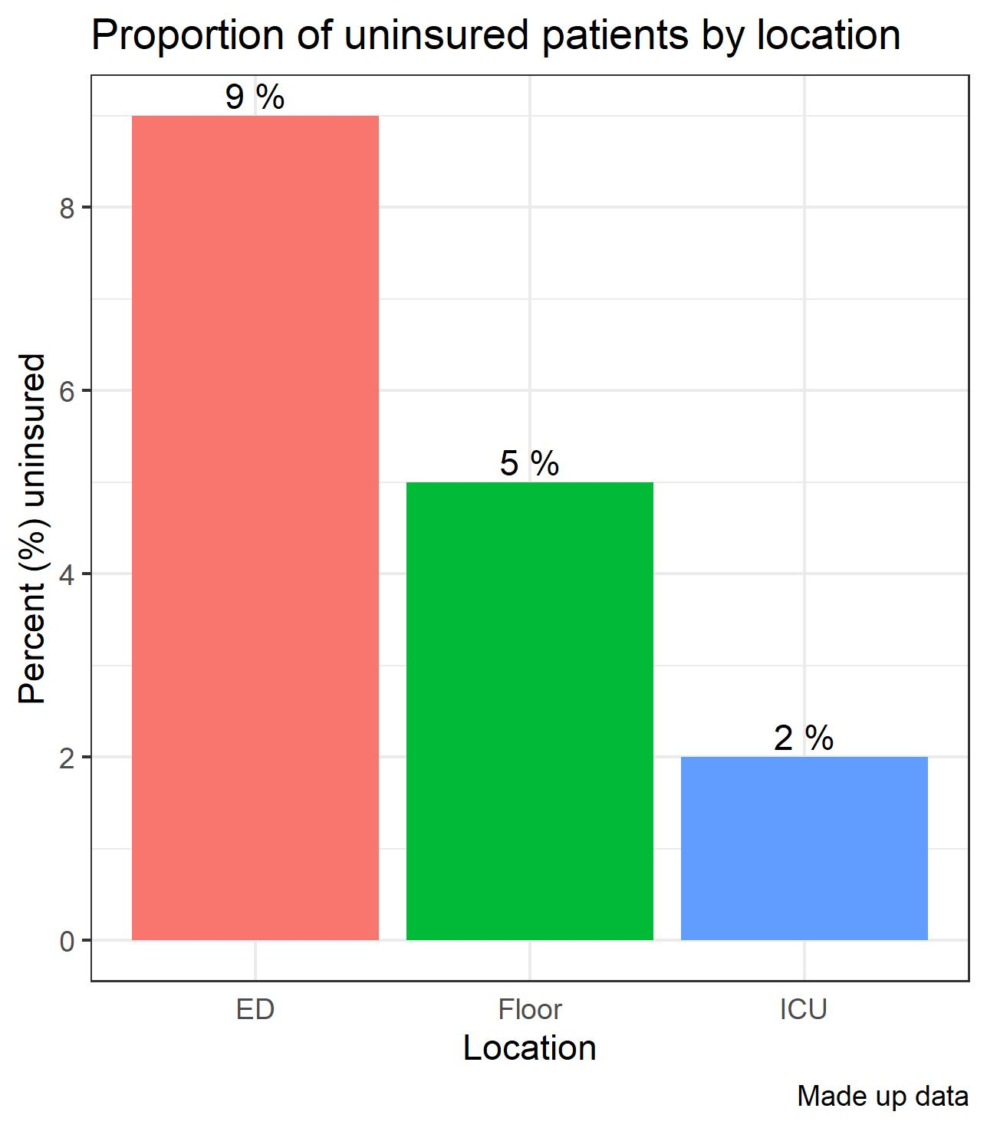
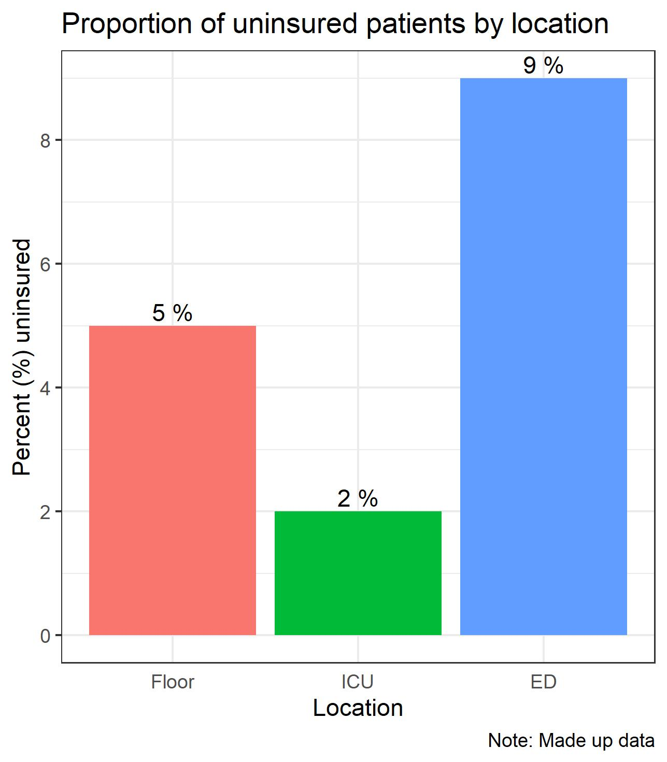
The bar chart – most common, easily understood, versatile chart
Use if you want to compare numbers/quantities/percentages among categories.
Feel free to arrange the order of the bars as you see fit.

Slide 33
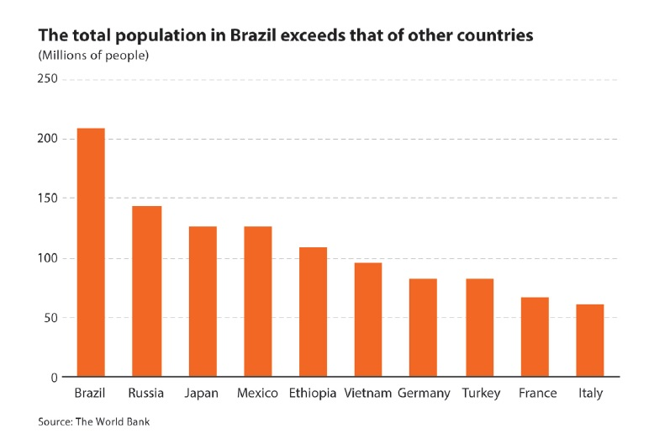
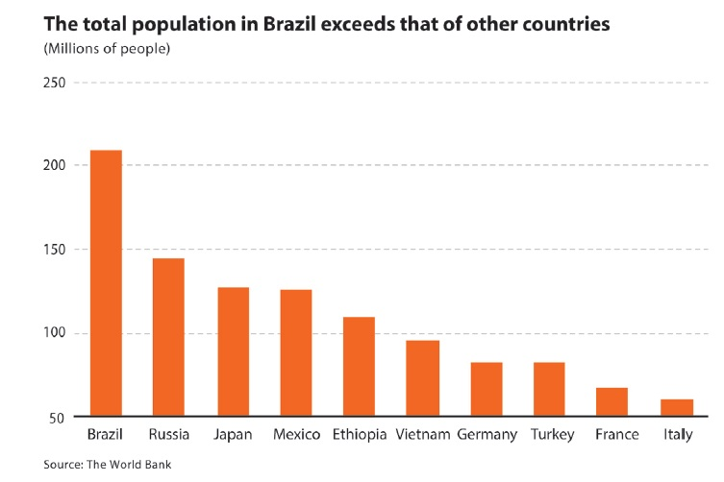
The bar chart – most common, easily understood, versatile chart
Try not to modify the Y-axis in a bar chart as it could deceive readers. It should start at 0.

Slide 34
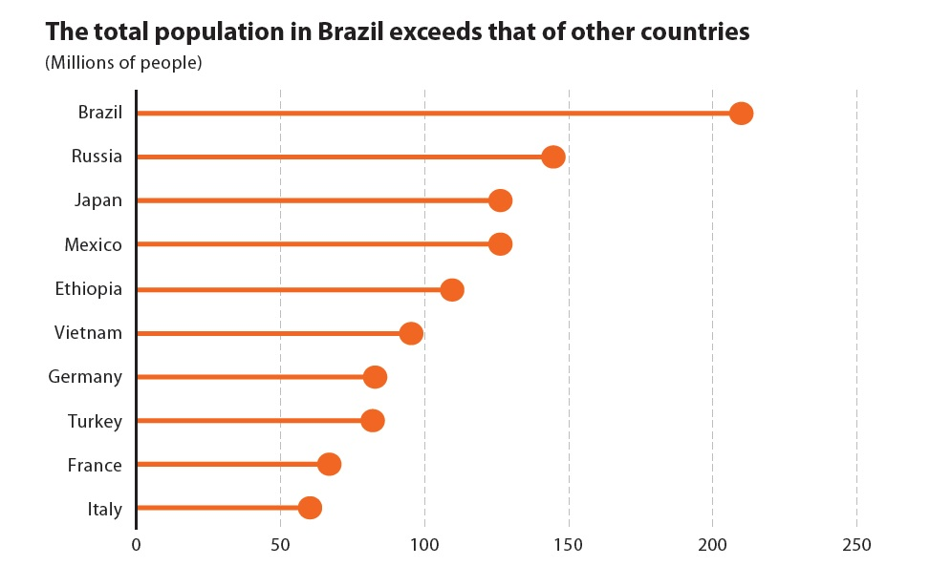
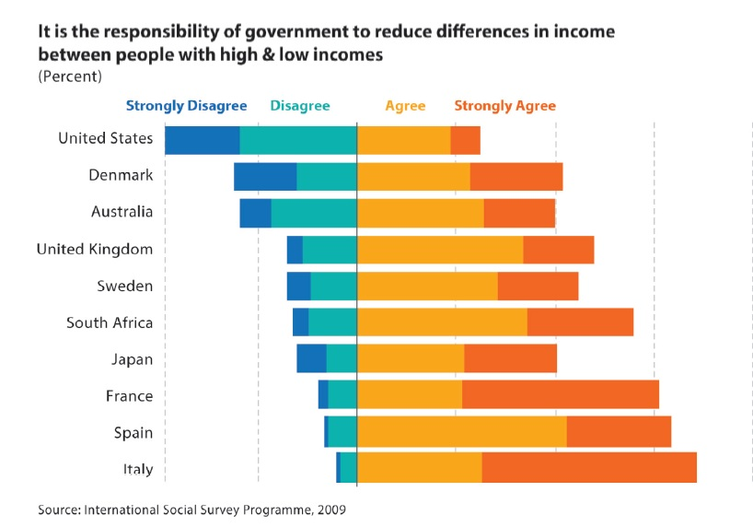
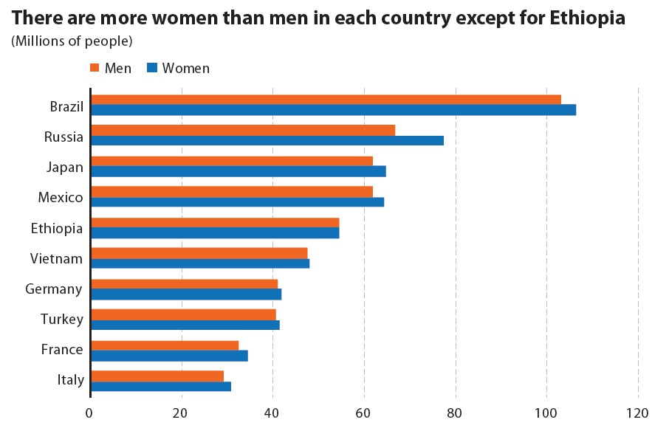
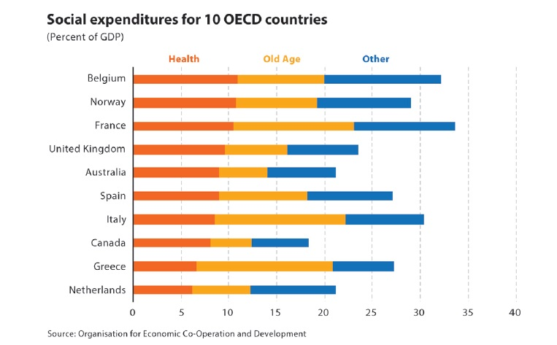
The bar chart – most common, easily understood, versatile chart
Tons of variations based off this chart.
Notes:
Can flip the chart. Paired bar chart, stacked bar chart, diverging bar, lollipop chart. Some people like to arrange this in circles (radial charts)

Slide 35
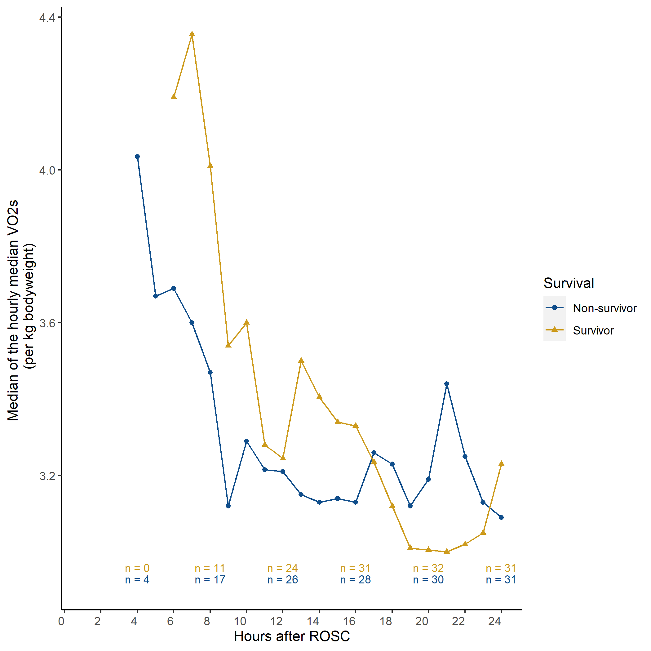
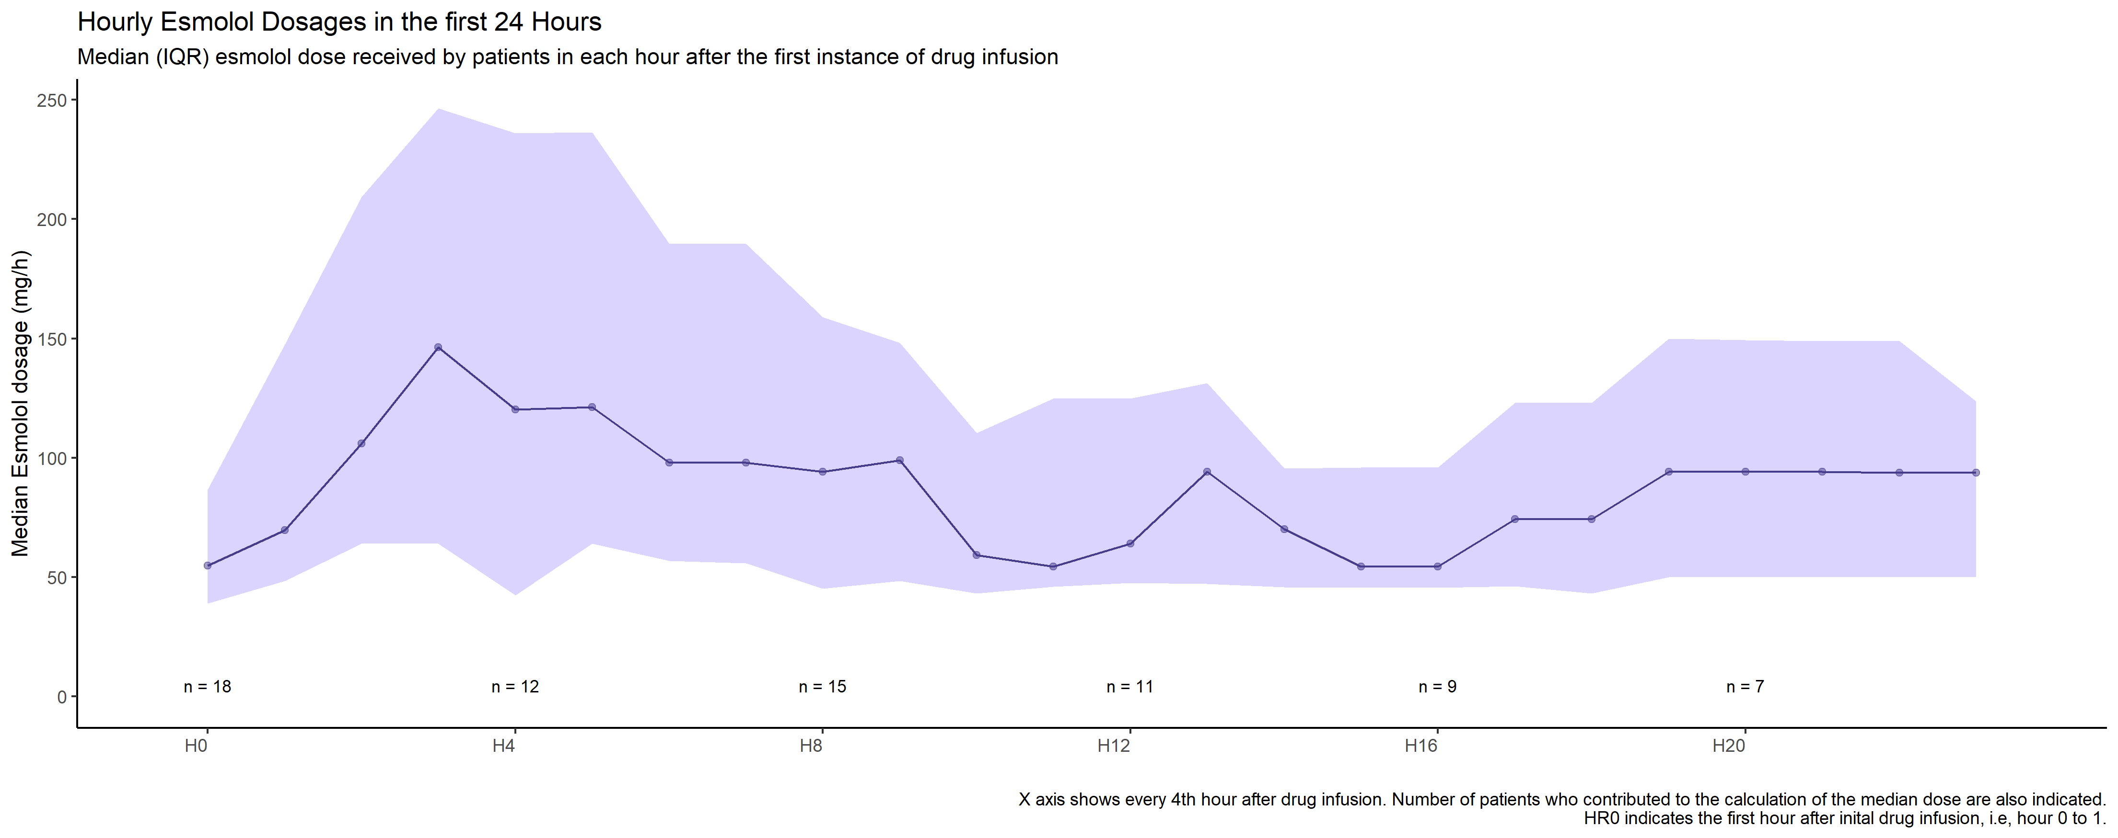
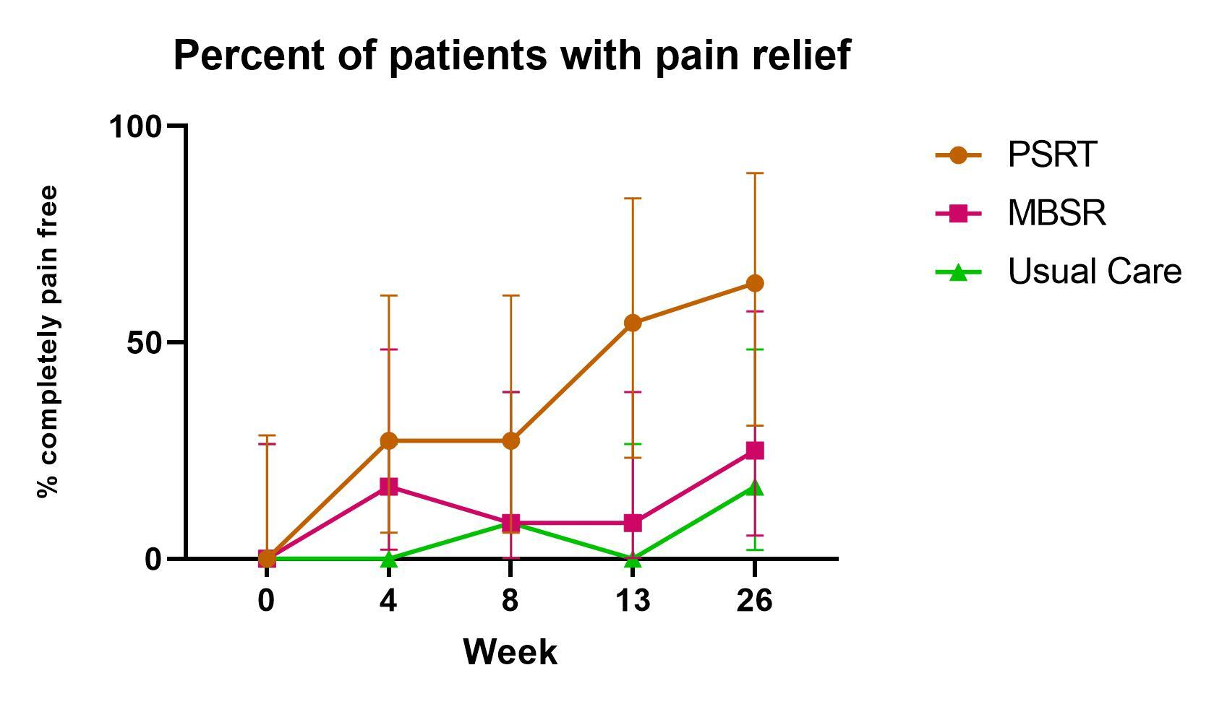
The line chart — useful to show passage/trends over time
Perfect to show how a number changes over time.
Great if you have a few lines (groups) to show.
Not a good idea if lines criss-cross too many times.
Notes:
No limit on number of lines you plot. Make sure grouped observations are clearly connected with lines. Y axis does not have to start at 0.

Slide 36
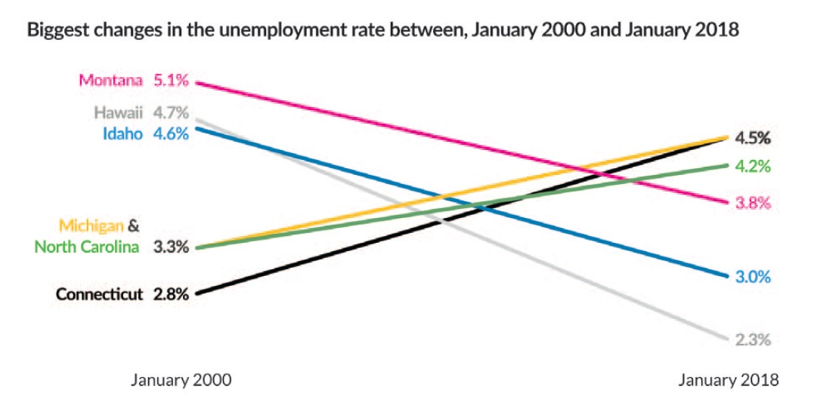
The line chart — useful to show passage/trends over time
Quite versatile – can be used to show medians (IQRs) and confidence intervals if needed.
Can be made quite minimal and converted into a slope chart if needed.
Notes:
No limit on number of lines you plot. Make sure grouped observations are clearly connected with lines. Y axis does not have to start at 0.

Slide 37
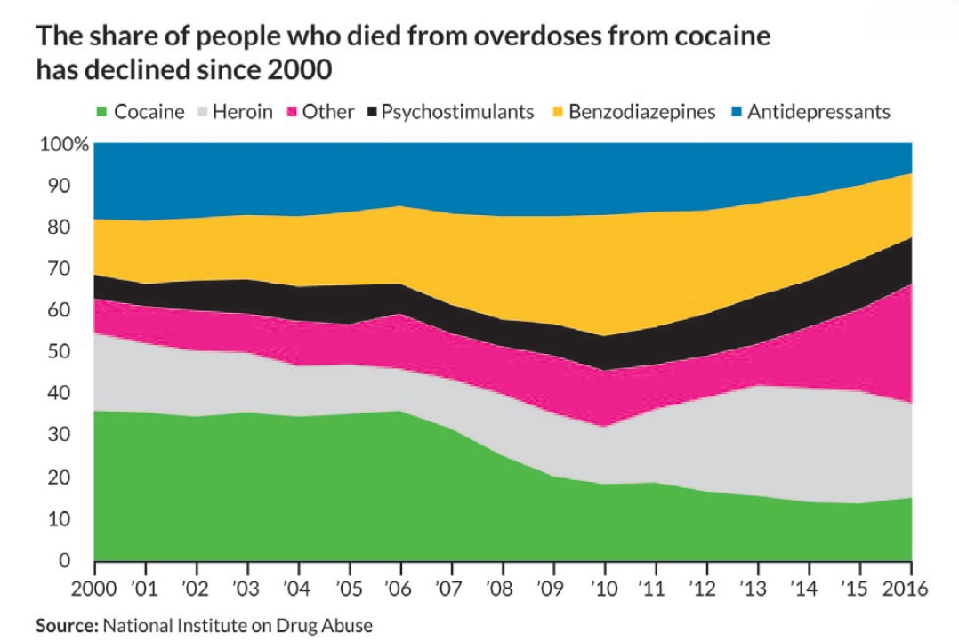
The line chart — useful to show passage/trends over time
The line chart can also serve as a template for more complicated figures, like the stacked area chart.
Notes:
No limit on number of lines you plot. Make sure grouped observations are clearly connected with lines. Y axis does not have to start at 0.

Slide 38
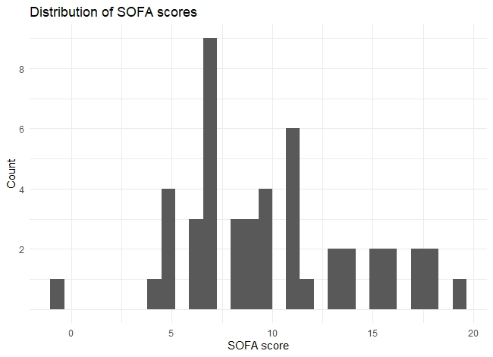
The histogram & the box-and-whisker plots: use for distributions
Use a histogram to show how one number is spread out with respect to itself.
sofa
9
11
7
9
8
8
7
5
10
11
(…made up data)
Sofagroup number
0-5 : 1
6-10 : 7
11-15 : 2
(…..)
Notes:
Great for checking normality.

Slide 39
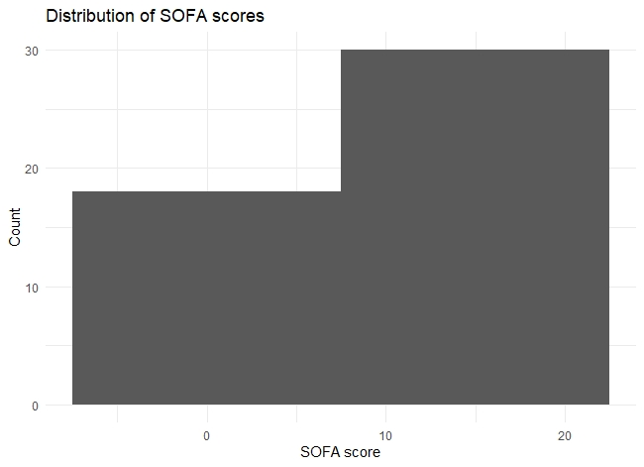
The histogram & the box-and-whisker plots: use for distributions
The width of the bins or buckets determines the shape of the histogram
sofa
9
11
7
9
8
8
7
5
10
11
(…made up data)
Sofagroup number
0-9 : 18
10-24 : 30
Notes:
No limit on number of lines you plot. Make sure grouped observations are clearly connected with lines. Y axis does not have to start at 0.

Slide 40
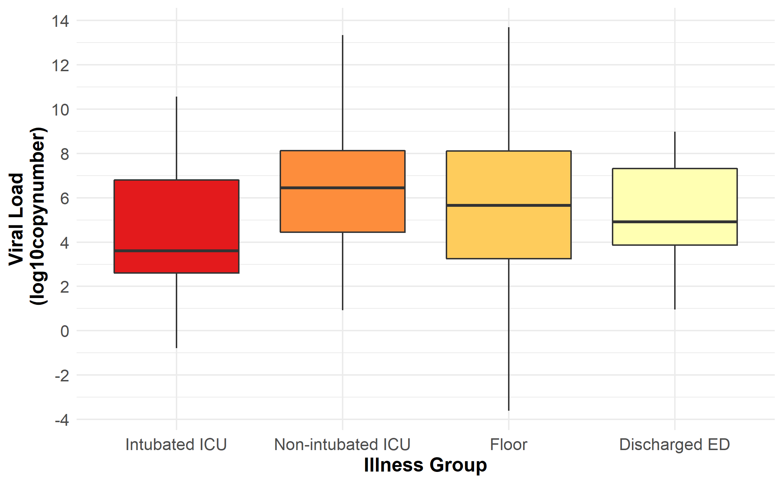
The histogram & the box-and-whisker plots: use for distributions
Use a boxplot to show how one number is spread out with respect to different groups.

Slide 41
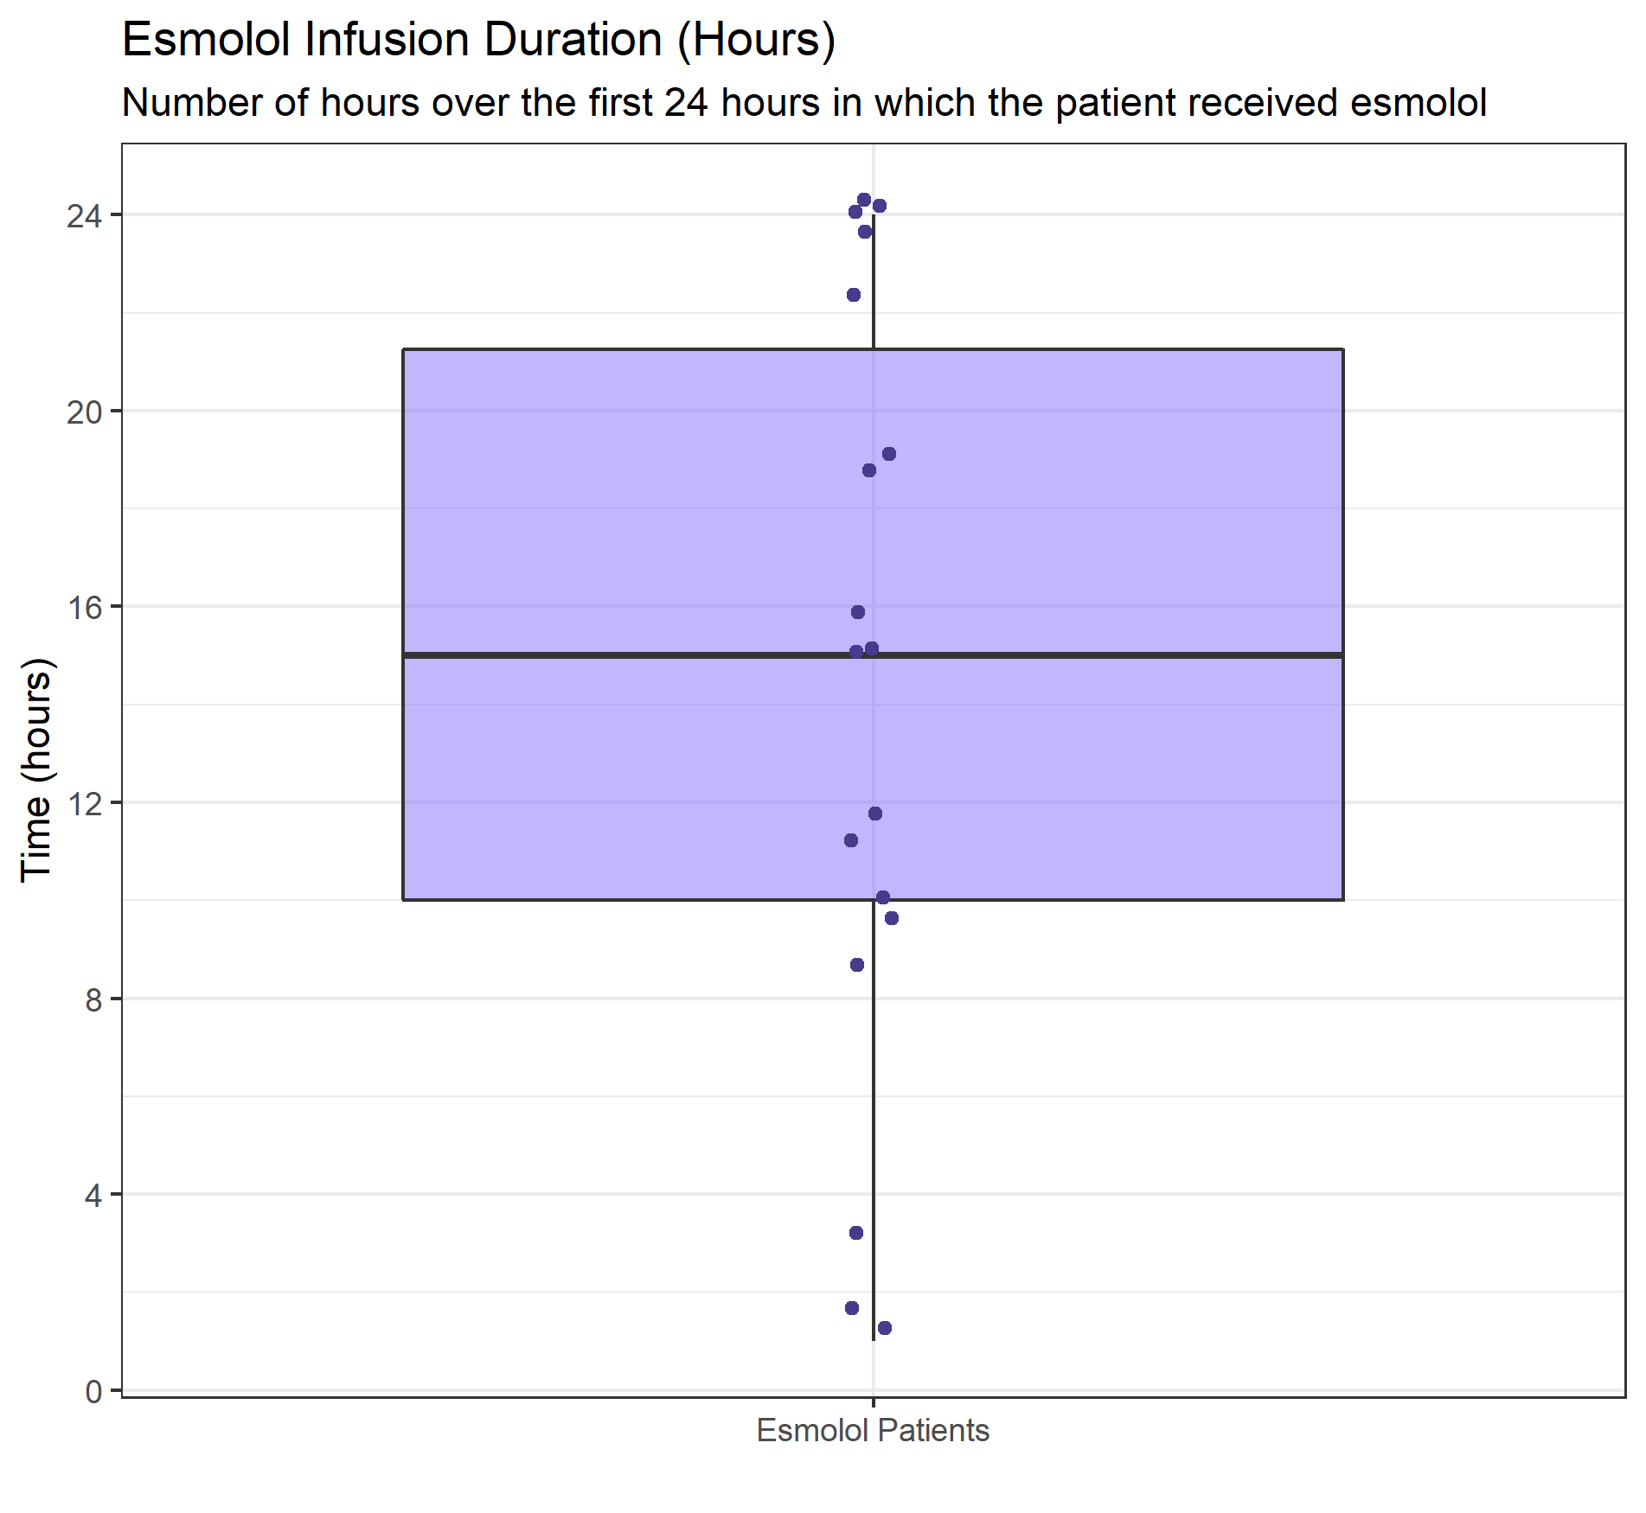
The histogram & the box-and-whisker plots: use for distributions
The boxplot makes it easy to identify median and IQR. Great for presenting non-normal data.
Q3
(whisker)
Median
IQR
Q1
(whisker)

Slide 42
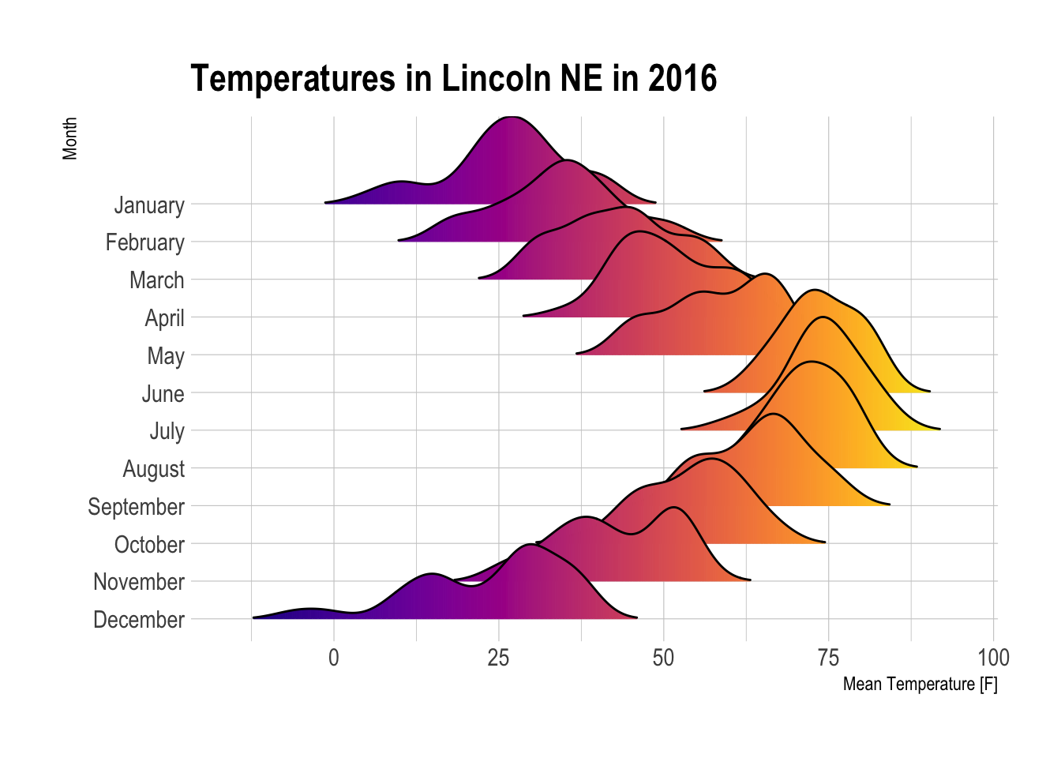
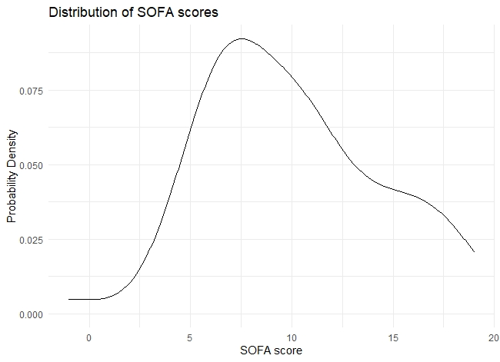
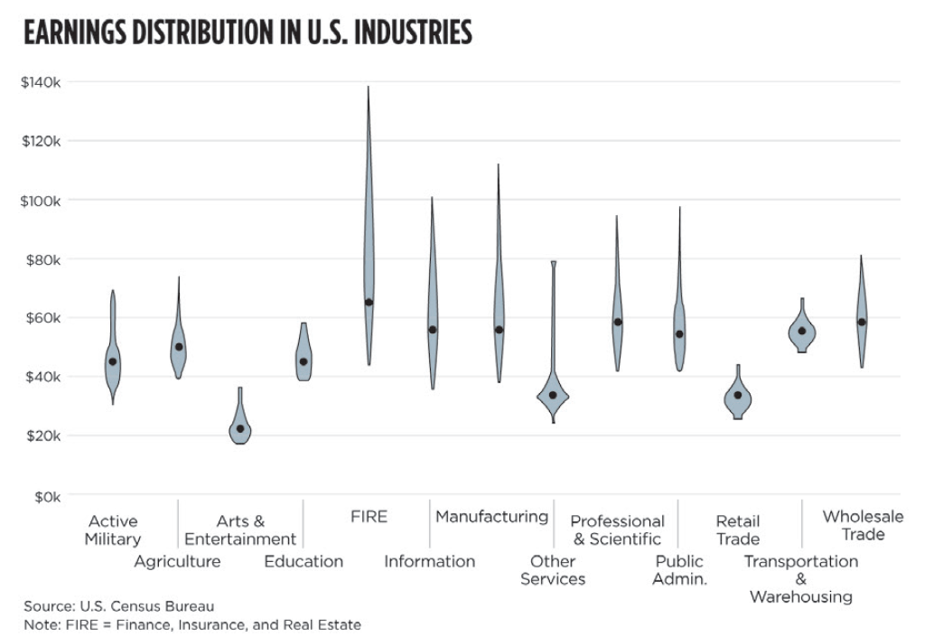
The histogram & the box-and-whisker plots: use for distributions
More complex distributional charts can be made from the basic histogram and boxplots.
Image from r-graph-gallery.com
Notes:
Density plot, ridge plot and violin plot using kernel smoothing

Slide 43
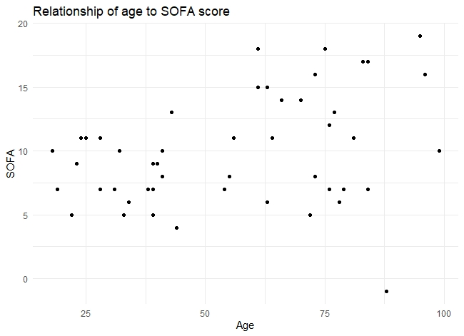

The scatterplot: use for relationships
To see how one number changes with another, use a scatterplot.
age | sofa
23 | 9
24 | 11
38 | 7
40 | 9
41 | 8
55 | 8
54 | 7
39 | 5
18 | 10
(…more made up data)

Slide 44

The scatterplot: use for relationships
Can add a third dimension using size.
age | sofa | bp
23 | 9 | 113
24 | 11 | 78
38 | 7 | 120
40 | 9 | 80
41 | 8 | 71
55 | 8 | 98
54 | 7 | 102
39 | 5 | 116
18 | 10 | 84
(…more made up data)

Slide 45

The scatterplot: use for relationships
These basic scatterplot principles can be used to map spatial data.
X (Long) | Y (Lat) | Prob
23’4” | 9’23” | 0.11
24’3” | 8’36” | 0.23
(…more made up data)

Slide 46


The pie-chart: Use to show parts of a whole
Use when it is important for you to show how different groups come together to constitute the whole population
There are disadvantages though.
Which is bigger, 1 or 5?
Notes:
There are other disadvantages. Cannot show too many slices. Cannot show change over time.

Slide 47


The pie-chart: Use to show parts of a whole
A good case to use the pie-chart is when one of your groups of interest sums to 25%, 50%, or
75%; it is easy in such cases to identify the angle in the pie.
Can use simplified pies to show cases where certain groups constitute the majority (above 50%)

Slide 48


Alternatives to the pie-chart
As alternatives to show parts of a whole, could use tree maps (also has the advantage of showing hierarchy) or Voronoi diagrams.

Slide 49

For qualitative data, could use word clouds.

Slide 50


For tweeting out papers, could consider using gifs to get attention.

Slide 51

Software that can be used for data visualizations
R (free). Very powerful. Takes a bit of time to learn initially but it is great for all figures.
Use in combination with Github and Git (free) for version control.
Python (free). Quite powerful, capabilities fast catching up to R.
YeD Graph Editor (free). Great for CONSORT diagrams and flowcharts.
QGIS (free). For spatial maps.
GraphPad (paid). Easy to learn, decent tutorials.
Excel (paid). Been around forever so tons of resources.
Tableau (paid). Creates very beautiful visualizations.
ArcGIS (paid). For spatial data visualization and spatial analysis.

Slide 52
References
All images that weren’t created by me personally were sourced from Jonathan Schwabish’s book: “Better Data Visualizations”, 2021 Columbia University Press. Great book for general data visualization information. Some sections in this presentation inspired by this book.
For help with using R for data visualization, check out “ggplot2: Elegant Graphics for Data Analysis” by the creator of R, Hadley Wickham. For more hands on practice, check out the #tidytuesday hashtag on Twitter.
For help with using Tableau for data visualization, check out the book “The Big Picture: How to Use Data Visualization to Make Better Decisions—Faster” by Steve Wexler. There are great public Tableau resources here: https://public.tableau.com/en-us/gallery/?tab=viz-of-the-day&type=viz-of-the-day

Slide 53
Thank you!
Notes:
In Slide Show mode, select the arrows to visit links.

